Slide 1
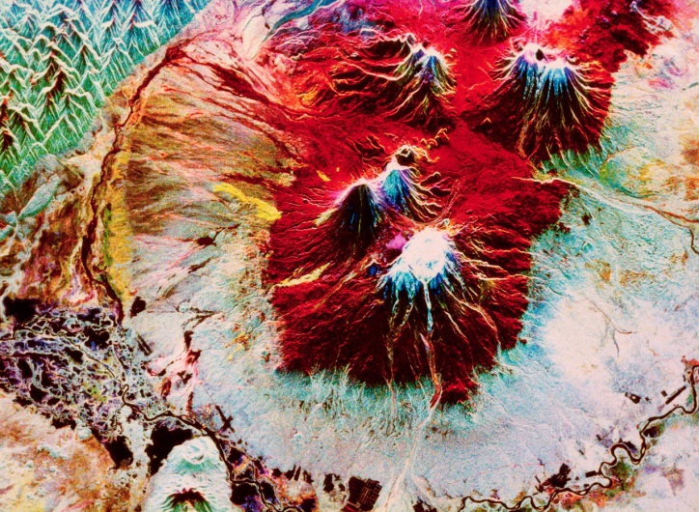
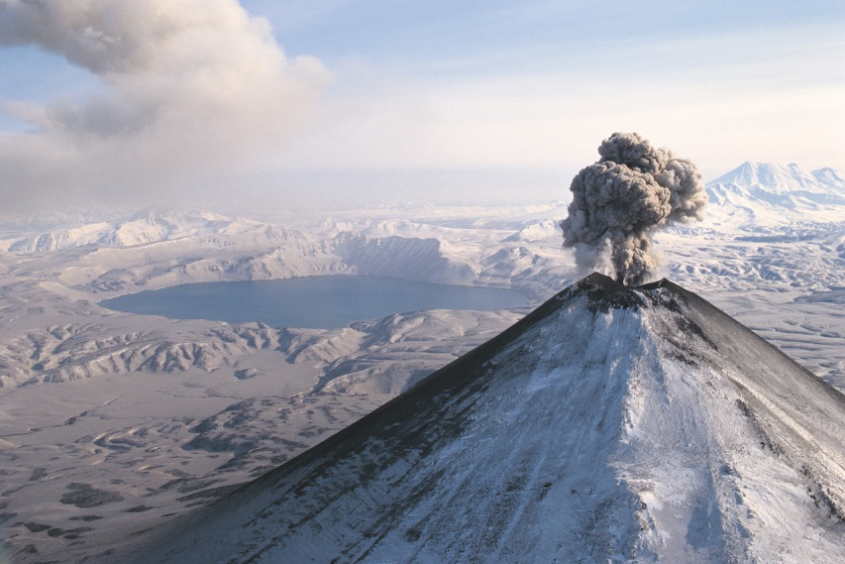
Volcanoes
By Zach

Slide 2
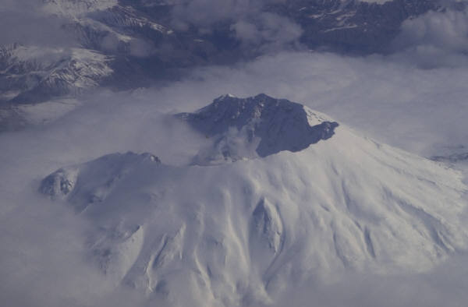
What causes them
Pressure builds deep inside the Earth.
Magma is pushed up to the surface.
The volcano erupts magma that reaches the surface it is called lava. It flows down the volcano.

Slide 3
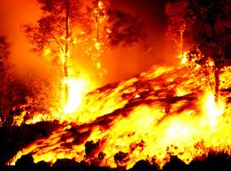
Volcanoes damage
Ash and dust fills the air they cover everything for miles around the volcano.
Volcanoes may cause earthquakes or landslides.
Some times they destroy crop and buildings

Slide 4
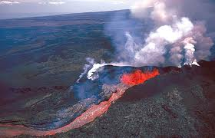
Where are they
Most volcanoes form near the edges form continents.
Many volcanoes make up a ring of fire.
This area circles the pacific Ocean some volcanoes are at the bottom of the oceans.

Slide 5
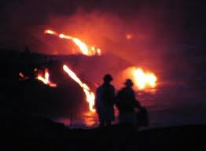
Studying volcanoes
Scientists watch volcanoes and measure their activity.
Scientists try to predict when volcano will erupt.
People can be warned to leave the area to stay safe.

Slide 6
What are they
Volcanoes are opening in Earth’s surface.
Some look like mountains. Others are flat and low.
When a volcanoes erupts it sends lava rocks gas and ash in to the air

Slide 7
Reference
http://www.pebblego.com/content/science/pgo_player.php

