Slide 1
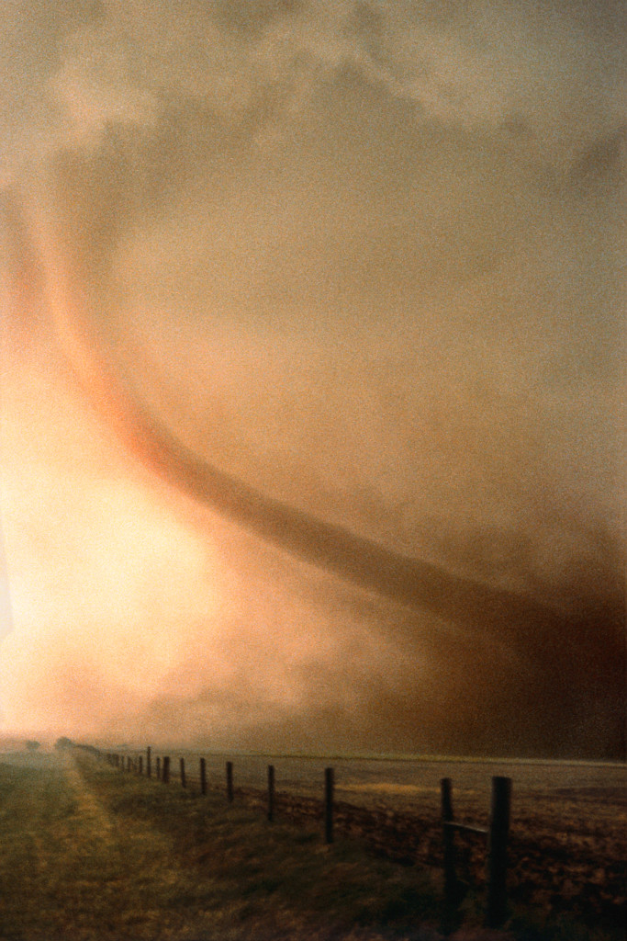
Tornados
By Vanessa wells

Slide 2
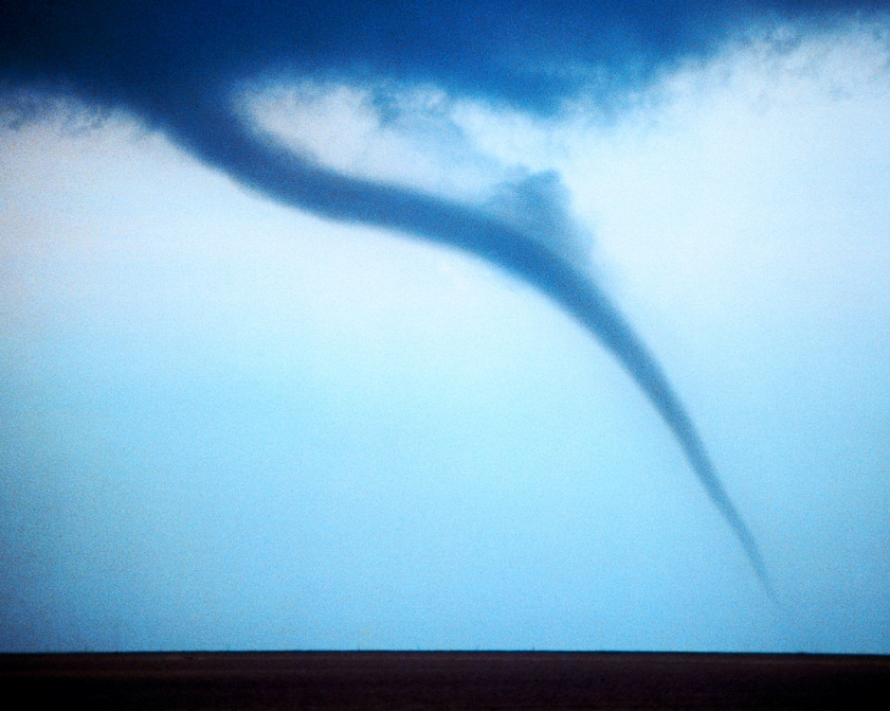
What are tornados
Tornados are a really big funnel and when that big funnel hits the ground it becomes a Tornado.

Slide 3
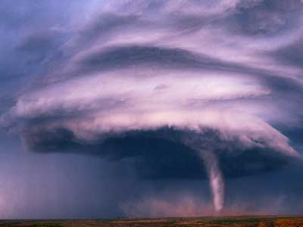
How do Tornados happen
Tornados mostly happen in the spring or the summer. Tornados happen when ever cold air masses meet worm air masses. Then the wind spins the cold air and the hot air together and the wind moves so fast it turns in to a Tornado.

Slide 4
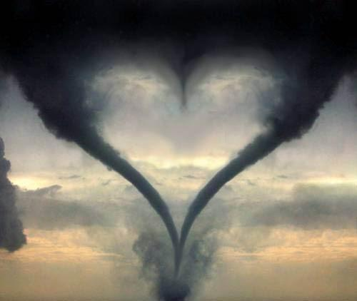
Where do they happen
Tornados can happen all over the world hundreds of tornados can happen each year they mostly happen in tornado alley.

Slide 5
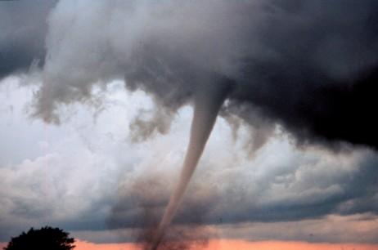
What do they do
Big and strong tornados can and will destroy any thing in their paths they can lifted up any tree and any car they can also tear a roof off of a building.

Slide 6
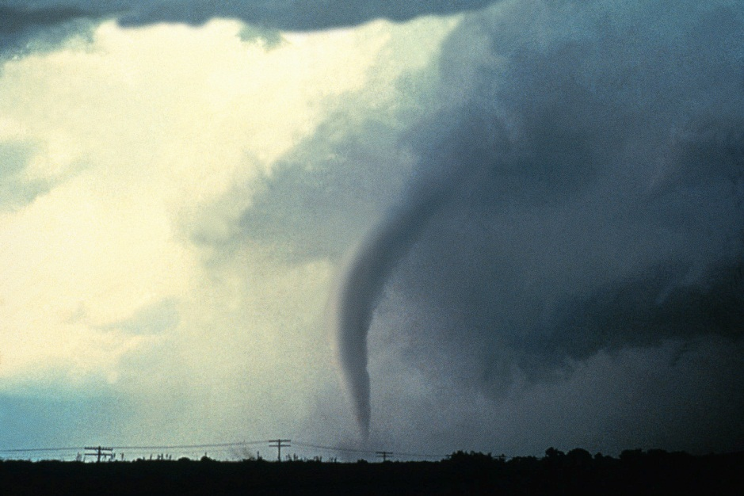
Tornado safety
For safety if a tornado comes you should listen for the sirens and hide in a room that has know windows or hide in a ditch.

Slide 7
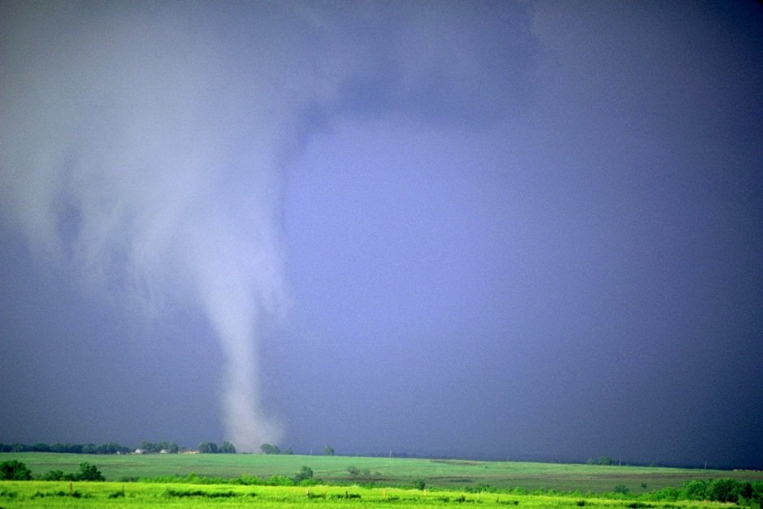
References
http://www.pebblego.com/content/science/pgo_player.php

