Slide 1
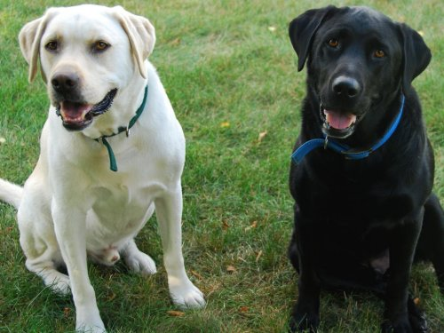
Dogs
By Tyler M.

Slide 2
Labs size
Lab retrievers are a size dog they are friendly dogs weigh 55 to 80 ponds

Slide 3
Labs body
A lab likes the water it has a tail like an otter to help them swim thick water

Slide 4
Labs life cycle
Female labs give birth to about 10 puppies grow quickly labs live to be 10 13 years old

Slide 5
Care
Owners give them food and water every day labs should get sun light dally

Slide 6
Fun facts
Labs are the most breed in the united stats hunters use labs to get dead birds

Slide 7
Size
Labrador retrieves are a medium size they are friendly dogs way 55 to 80 pounds. A lab likes to be in water it has a tail like otter to help them swim.

Slide 8
References
http://www.pebblego.com/content/animals/pgo_player.php

