Slide 1
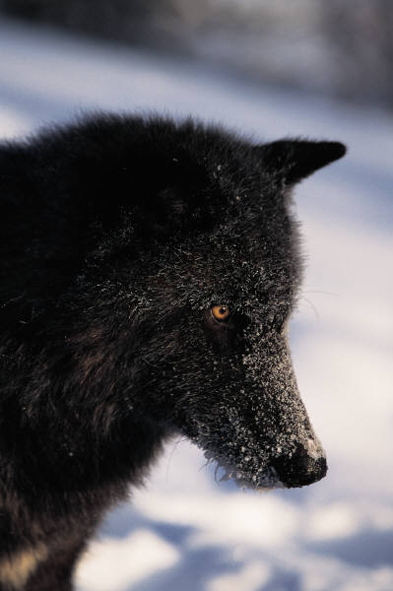
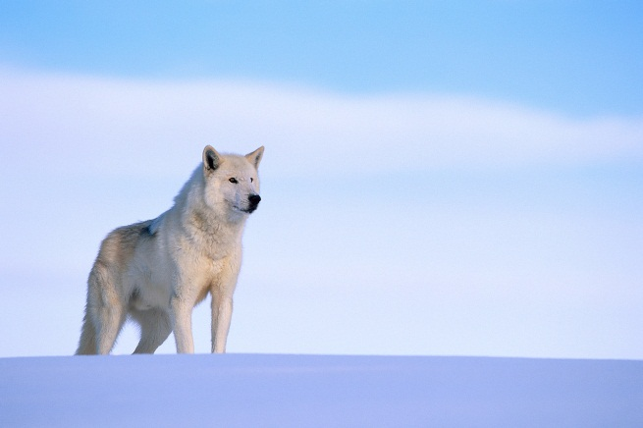

Wolves
By Taidym

Slide 2
body
Wolfs are related to dogs.
They have thick fur it can any shade of back white, and , brown, red.
Auld wolfs weight to 75 to 127 pound.

Slide 3
habitats
Wolf lives in packs.
The wolf are found in Asia, north America, and Europe.
Wolf in forest and mountains.

Slide 4
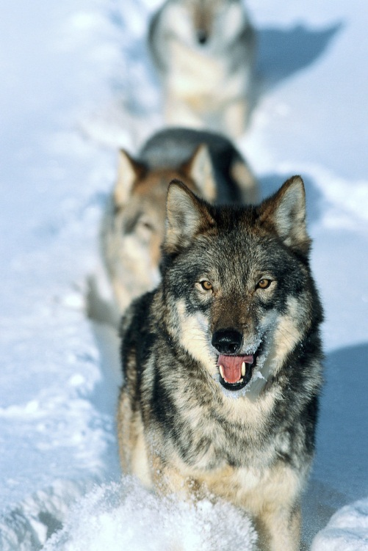
Food
Wolfs eat Deer, Moose, and elf .
They even eat meat.
They have sharp teeth and sharp claws.

Slide 5
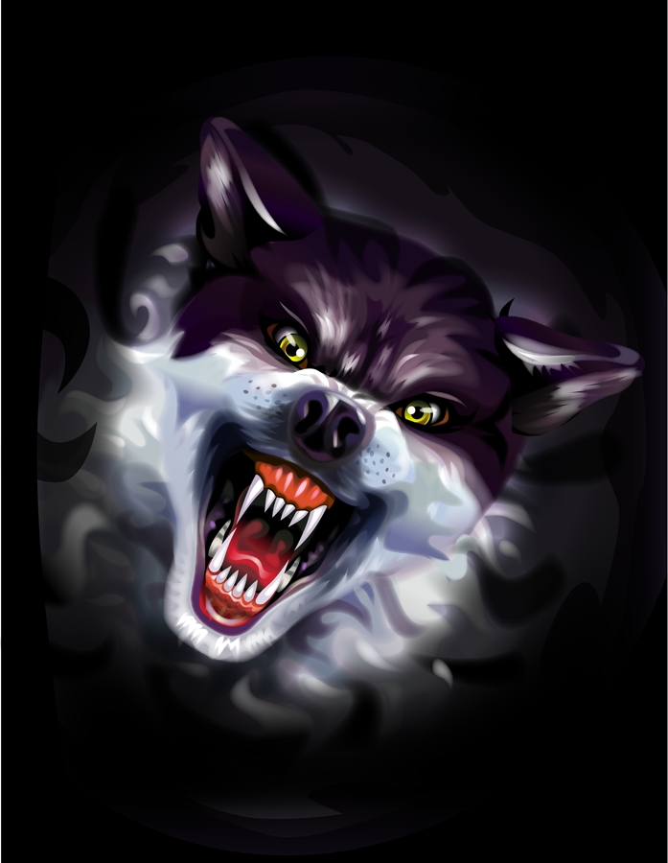
Live cycle
Litters have about 6 wolf pups.
Female wolf give birth about 60 days.
Wolf mate in spring time.

Slide 6
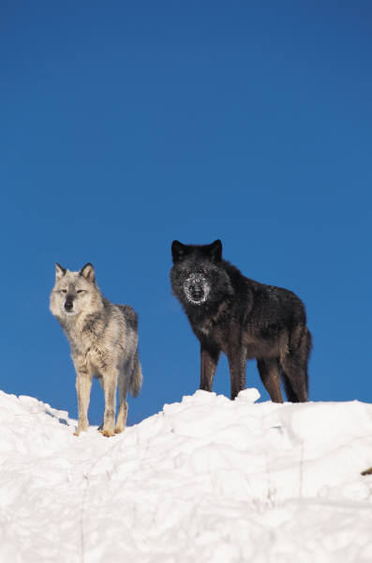
Fun facts
Wolfs pack plays together and sleep.
Wolfs sense of smell 100 times better.
Wolfs barks and grown .

Slide 7
To look
http://www.pebblego.com/content/animals/pgo_player.php

