Slide 1
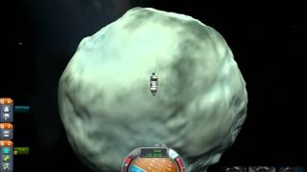
The Dwarf Planet
By Tahj Harden

Slide 2
What is a dwarf planet
A dwarf planet is a small planet but it is not consisted a planet
Pluto is a dwarf planet
but Scientists say Pluto is not a planet at all it
is to small to be a planet

Slide 3
What is Pluto
Pluto is far past Neptune
It is also vary far away from the sun
Scientist belief Pluto is not a panet but a rock

Slide 4
The core
Pluto is made out of rock and frozen water
Moat of the planet is the mantle
The thinnest layer is the crust

Slide 5
Three moons?
Did you know Pluto has three moons?
The biggest is named Charon
The next two are called Nix and Hydra

Slide 6
A CLOSER LOOK
There was a space craft called New Horizon
It was launched in 2006 it will arrive at Pluto in 2015
new horizons might be the first settle light to have taken close up pictures

Slide 7
Reference
http://www.pebblego.com/content/science/pgo_player.php

