Slide 1

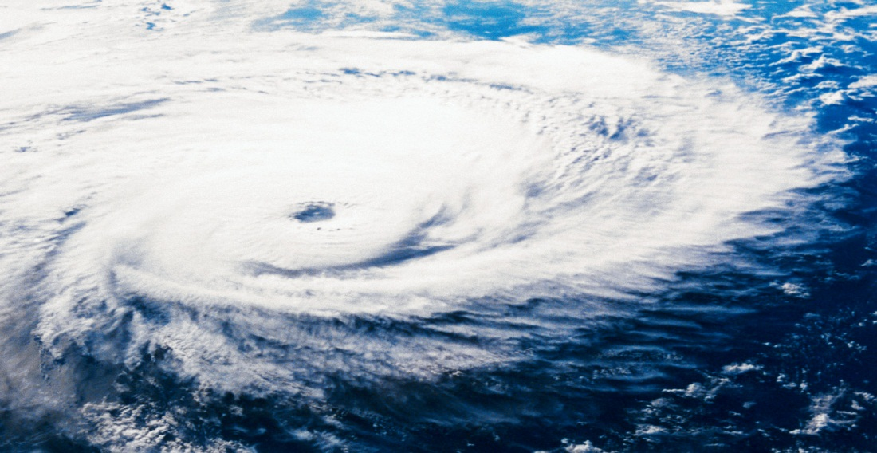
Hurricanes
By Sydni Fletcher

Slide 2
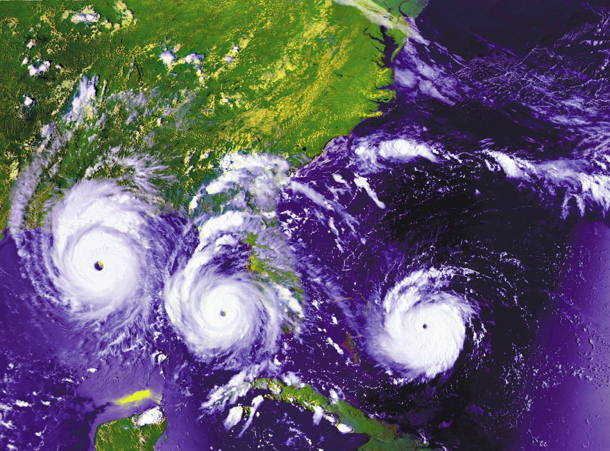
What Are They?
Hurricanes can be very LARGE.
They are made from the ocean, they are big winds with water that flood onto the shore.
Hurricanes form from cold and warm weather.

Slide 3
How Do They Start?
Wet air forms above warm oceans.
The wind and rain starts to blow hard and make many thunderstorms.
The storms come together spinning in circles.
The middle of the hurricane is called the eye.

Slide 4
Who Studies Them?
Meteorologist study them.
They use satellites and Radars to show a hurricanes path through the storm.
Hurricane hunters fly airplanes to check on the hurricane to see how it is forming.

Slide 5
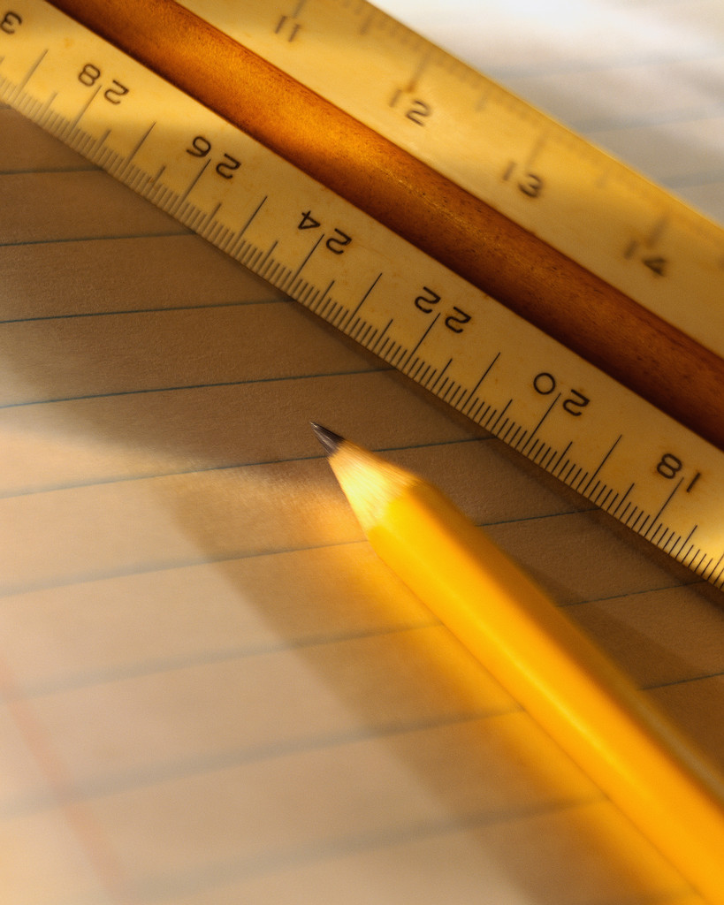
How Are They Measured?
A hurricanes strength is measured by its wind movement.
It is given a number from One to Five on how Intense the storm is going to be.
The One to Five rating is given by the Saffir - Simpson scale.

Slide 6
Staying Safe.
Hurricanes can destroy houses and towns with wind and water.
Listen to what's happening on the radio or TV.
Listen to the warnings that tell people to evacuate.

Slide 7

Reference Page
http://www.pebblego.com/content/science/pgo_player.php

