Slide 1
Bulldog
By Seth Littles

Slide 2
Size
Bulldog are short and wide
They grow to 12 to 16 inches
Weigh about 50 pounds

Slide 3
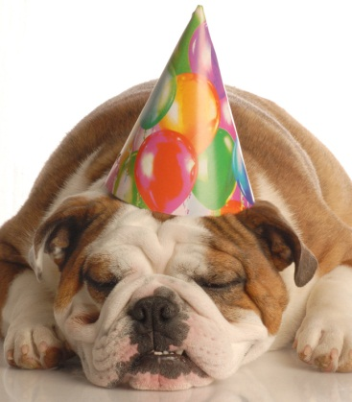
Body
A bulldog hade is the seem too big for body
Its face is lined
A bulldog is short

Slide 4
Life Cycle
Bulldog have four or five in a litter
The have big heads
They live seven to nine years

Slide 5
Care
They food and warder
To sort wakes
Even them bath a week

Slide 6
Fun Fates
Bulldog the fumes animals
A good pets
They have

Slide 7
Reference page
http://www.pebblego.com/content/animals/pgo_player.php

