Slide 1
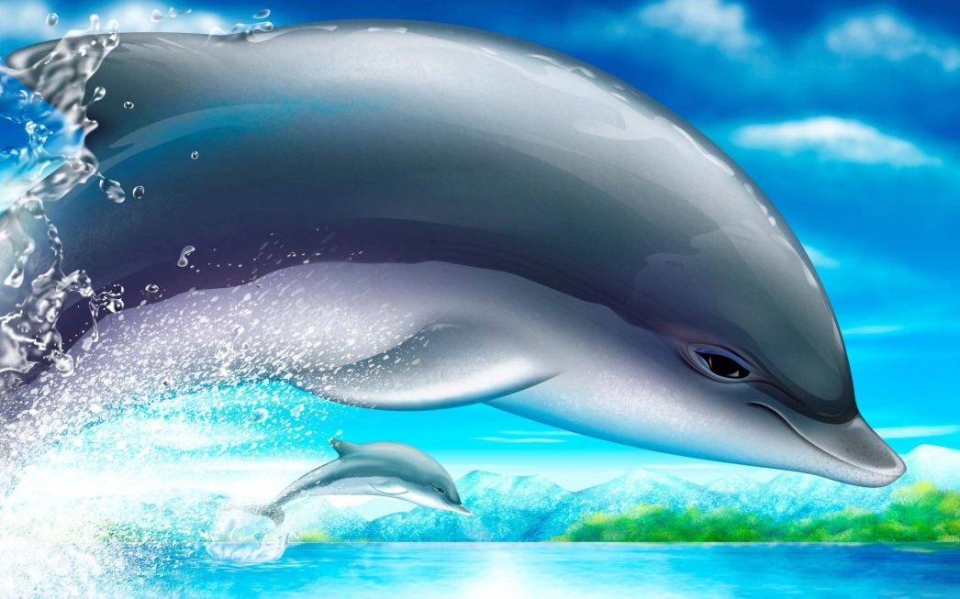
Dolphins
By Sara Marrufo

Slide 2
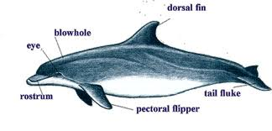
Body
Dolphins are sea animals.
There body can get up to 30 feet long.
Dolphins use there tail flukes up and down to swim.
Dolphins use flippers and a dorsal fin to steer.

Slide 3
Habitat
Dolphins live in oceans. Salt water keeps there skin soft.
Most dolphins live In warm water close to the equator.
Some dolphins can be found in rivers.

Slide 4
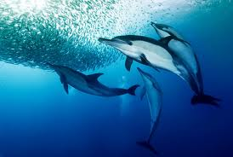
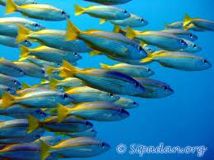
Food
Dolphins eat fish, shrimp, and squid.
They work in groups by surrounding and catching the prey.
Dolphins grab there prey with there sharp teeth.
They swallow the prey whole.

Slide 5
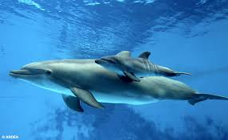
Life cycle
A female dolphin gives birth to one calf at a time.
Baby dolphins are about 4 feet long.
Mothers help there young get up to the surface for air.

Slide 6
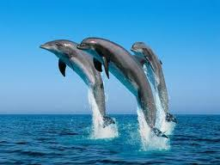
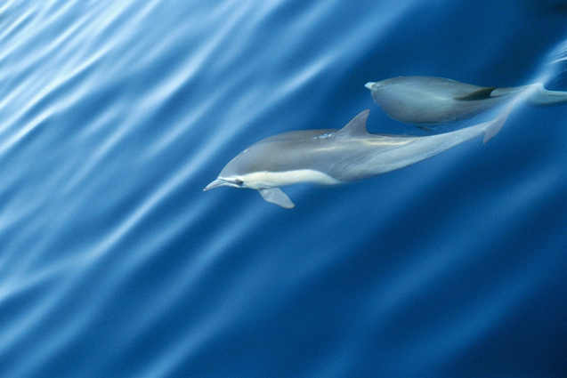
This is how dolphins look like

Slide 7
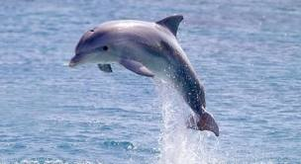
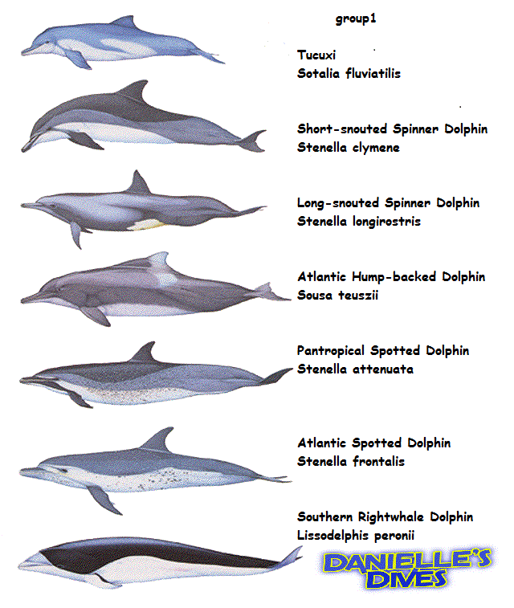
Fun facts
Dolphins can jump 16 meters high.
There are about 32 different kinds of dolphins.
Dolphins use blowholes on the top of there heads

Slide 8
References
http://www.pebblego.com/login.php

