Slide 1
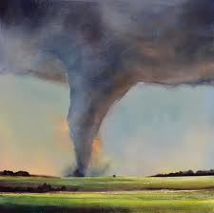
Tornadoes
By: Rebecca Niculcea

Slide 2
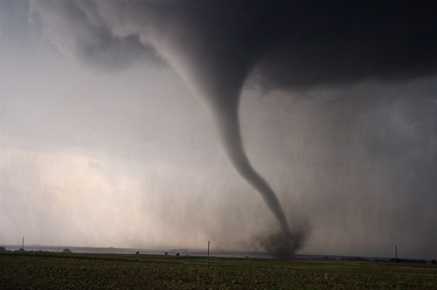
What Are They?
A swirling funnel of wind
Very strong windstorm
When it touches the ground it is a tornado

Slide 3
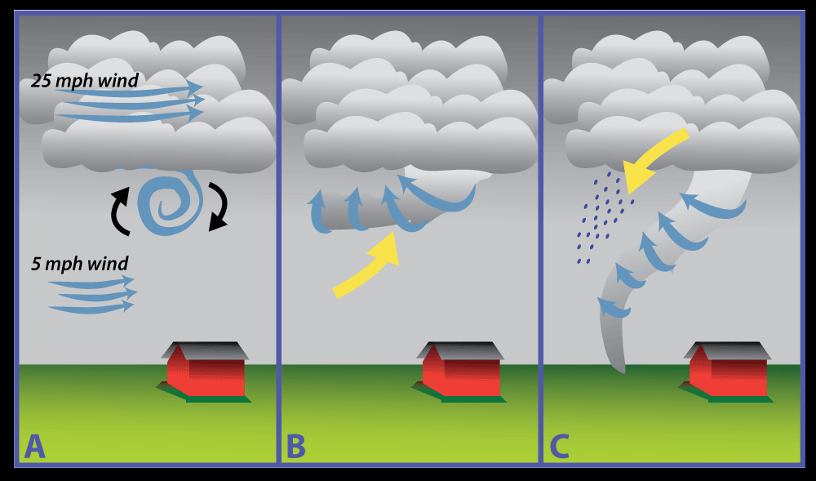
How do They Happen
In spring and summer storms
When warn air masses met with clod air masses
Wind spins the air into a funnel cloud

Slide 4
Where Do They Happen
All over the world
Most likely in Tornado Alley
Happen in the central United States most of the time

Slide 5
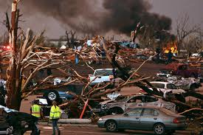
What Do They Do?
Destroys anything In there way
Spinning winds rips the roofs off building
Tornados can smash car and trucks

Slide 6
Tornado Safety
Listen to warnings on the radio
If you are outside find a ditch and cover your head
During warning go in a basement or a windowless room

Slide 7
Reference
http://www.pebblego.com/content/science/pgo_player.php

