Slide 1
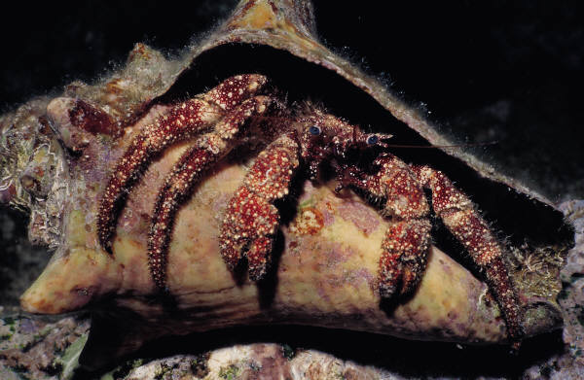
HERMIT CRABS
BY PROMISE

Slide 2
body
t

Slide 3
care

Slide 4
food

Slide 5
Life cycle
Live at the ocean
habitat can be a good place for hermit crabs
you can buy them at the store

Slide 6
Fun facts
You have to keep your hand out so it want pinch you
they love to be with ather

Slide 7
References
http://www.pebblego.com/content/animals/pgo_player.php

