Slide 1
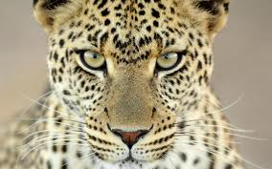
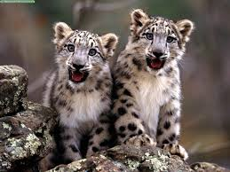
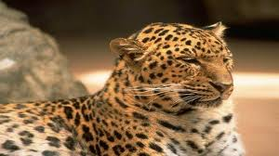
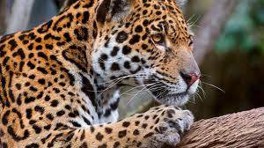
Leopards
By. Phoebe

Slide 2
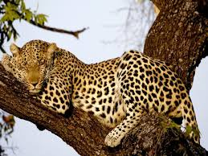
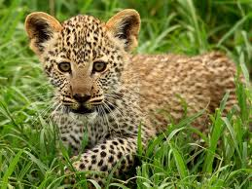
Habitat
Africa and Asia
And forest
Grassy places

Slide 3
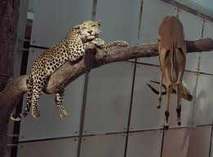
Food
Dear
Zebras
Gazelles
birds

Slide 4
Life Cycle
Female leopards give birth to two to three cub only at a time.
Cubs learn how to hunt.
And to protect themselves.
Leopards can only live about 15 to 20 years in the wild.

Slide 5
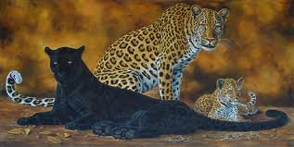
Body
Leopards are large wildcats.
They weigh about 60 to 200 pounds and 27 to 91 kilograms.
Leopards have pretty spotted fur.

Slide 6
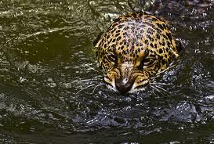
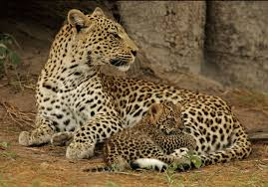
Fun Fact
Mother leopards protect there cubs from enemies by carrying there cubs up trees.
The cubs learn to hunt by catching mice and rabbits.
The leopards are good swimmers

Slide 7
References
http://www.pebblego.com/content/animals/pgo_player.php

