Slide 1
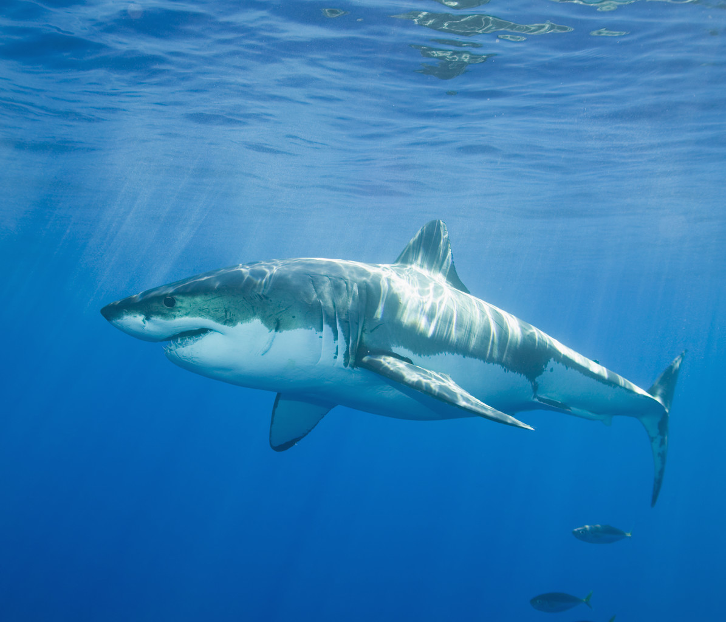
Great White Sharks
By Natalie Sipe

Slide 2
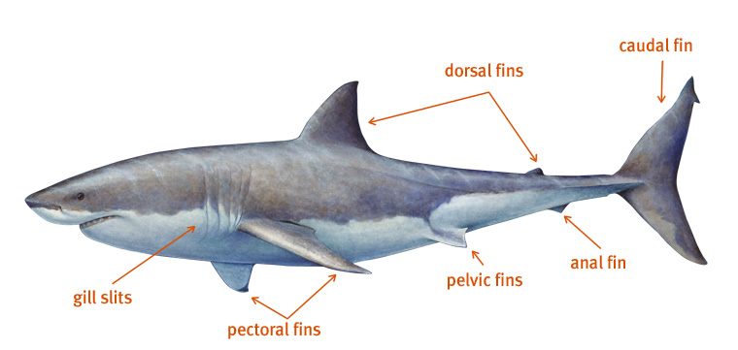
Body's
Grow up to be 20 feet and 6 meters long
The Toomey is white and the back is gray
Great white sharks are also fish.

Slide 3
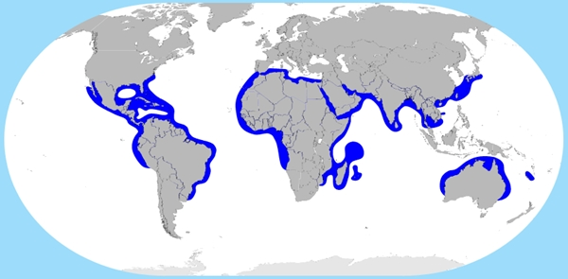
Habitats
Great white sharks live in parts of the ocean
Great white sharks usually live in cool water
They swim in shores to find food too.

Slide 4
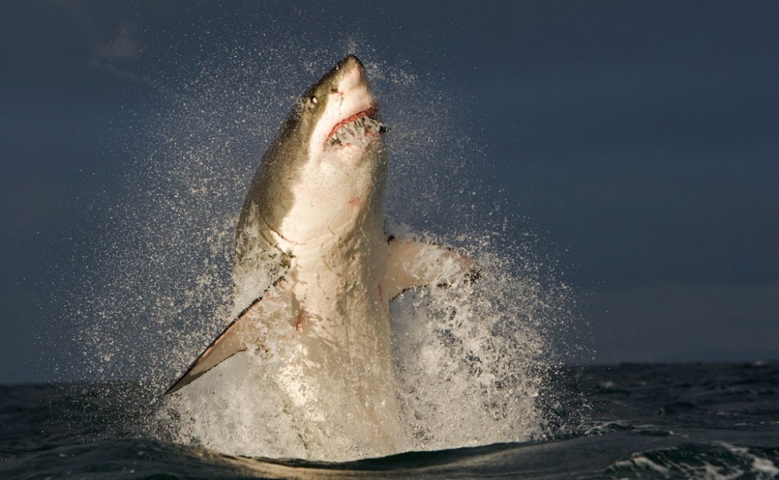
Foods
Great white sharks hunt down seals, sea lions, and also dolphins.
They jump out of the water to catch pray.
And bite their pray with their teeth

Slide 5
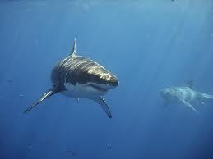
Life Cycles
Female great white sharks give birth about to two to 10 baby sharks at a time.
The baby sharks grow all by their own.
Great white sharks live to be 25 years old.

Slide 6
Fun Facts
Great white sharks have more than 3,000 teeth.
Great white sharks are the largest hunting fish in the world.

Slide 7
http://www.pebblego.com/content/animals/pgo_player.php

