Slide 1
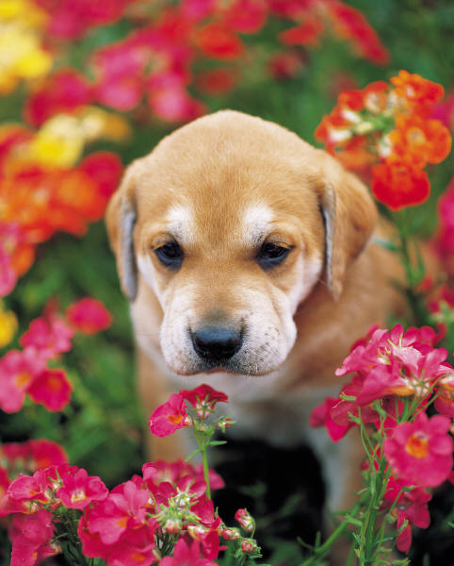
Animals in Winter
By Miranda Bond

Slide 2
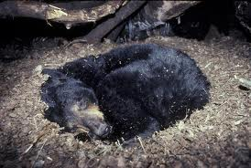
Hibernating
Days are long nights are long
They are in a deep sleep
There body tempera

Slide 3
Finding food
Animals hunt for food in the summer
Some birds find food left in birds feeders
Deer look for plants under the snow

Slide 4
migration
Many animals migration before winter
Gees and ducks spend the winter in lakes
Butterflies spend there winter in worm mexico

Slide 5
What happens
Days in the winter are sort
Winter night are long
Animals sleep longer during winter days

Slide 6
Blending in
Snow lets some animals hide
Some animals blind in with the sow
Weasels are white in the winter

Slide 7
reference
http://www.pebblego.com/content/science/pgo_player.php

