Slide 1
Every thing you need to know about cheetahs
By: Merritt Allen Dickens

Slide 2
A cheetahs body
A full grown cheetahs body is 7 feet long from tail to head.
There body is a yellowish tannish color with dark black spots.
Cheetahs use there strong lags to jump off and stars sprinting to get food.
A cheetah uses it’s long tail to turn really fast when a chase, to get food.

Slide 3
Where cheetahs live
About 76% of cheetahs live in Africa
About 24% of cheetahs live in Asia
Cheetahs live in grass areas called savannas.

Slide 4
How fast can a cheetah run
A cheetah is the fast animal.
They can run 70 miles per hour but some cheetahs can run 71-72 miles per hour
A cheetahs speed helps them catch their food

Slide 5
From prey to predator
A female can give birth to 3 or five cubs at a time.
In the wild a cheetah can live to be 10 or12 years old.
Soon the cubs get old enough to live on their own.

Slide 6
Fun facts
Mom cheetahs chirp to call the cubs
Cubs are baby cheetahs
The black strips near their eyes protect their eyes from the suns light

Slide 7
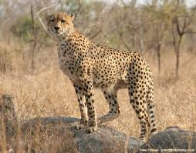
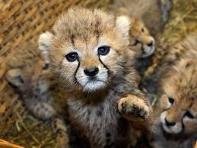
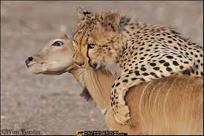
PICTUREs

Slide 8
Reference
http://www.pebblego.com/content/animals/pgo_player.php

