Slide 1


Tornadoes
By Mason

Slide 2
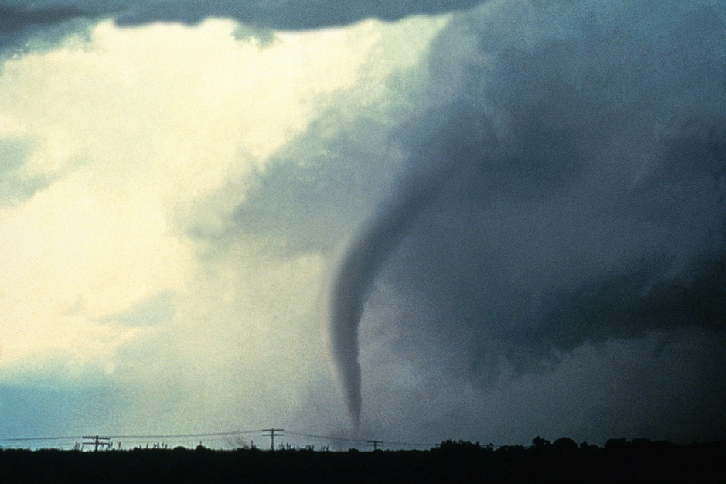
What are the?
Dusters
Wind
Picks up things

Slide 3
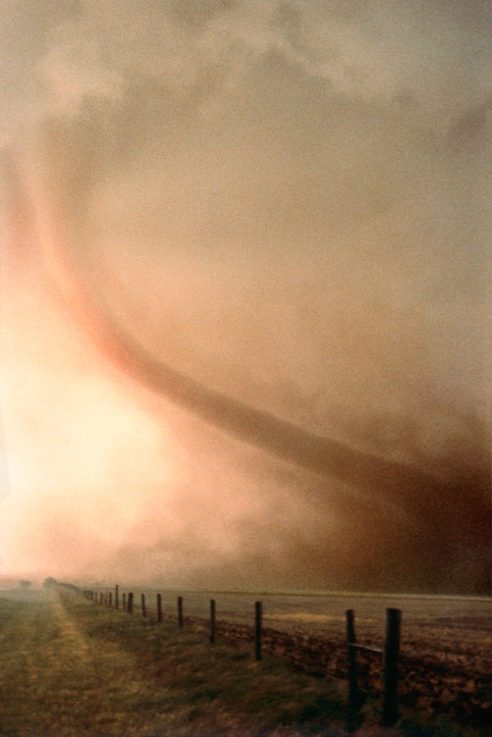
How do they happen
Cold and warm air misc
Spring
Summer

Slide 4
Where do they happen
All around
Hundreds
Tornado Alley

Slide 5
What do they do
Destroy
Smashed
Even cars

Slide 6
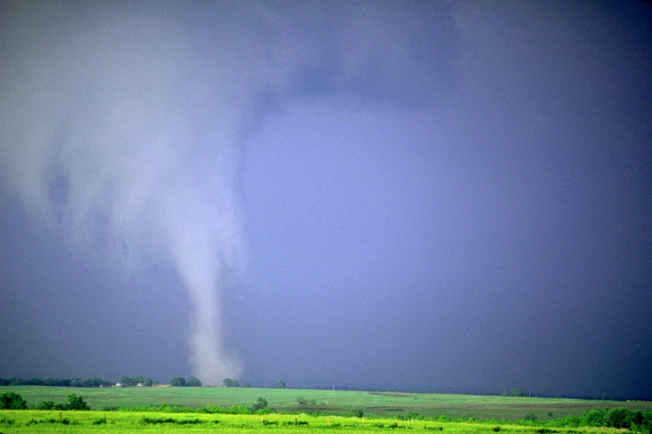
Tornado safety
Ditch
Basement
Bath room

Slide 7
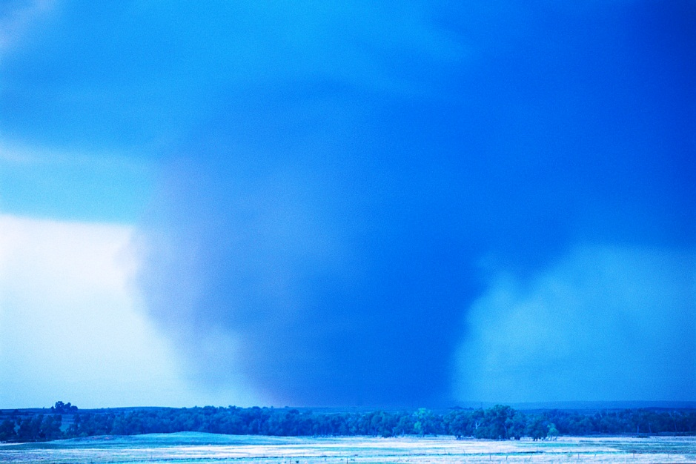
Reference
http://www.pebblego.com/content/science/pgo_player.php

