Slide 1
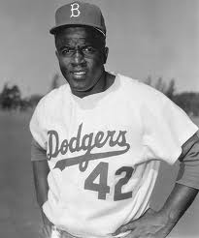
Jackie Robinson
By: Maddie Langum

Slide 2
Introduction
Jackie Robinson was born in 1919.
Poor Jackie. His family was poor.
Jackie went to school and worked part-time to raise money for his family.
He was born in Georgia.

Slide 3
Early Life
Jackie played baseball in high school and college and was a superstar.
He left college to help earn money for his family.
Jackie joined the army in1942.
Some army officers treated him wrong because he was African American.

Slide 4
Life’s Work
In 1945 Jackie played for the Kansas City Monarchs baseball team.
They were in the American Negro League.
African Americans were not yet allowed to play on a major league baseball team.

Slide 5
Later Years
In 1947 Jackie became able to play on a major league team.
He was the first African American baseball player to play on a major league team.
He played for the Brooklyn Dodgers for 10 years.
Some of his teammates treated him unfairly.

Slide 6
Contributions
In 1962 Jackie was awarded with the honor to be in the Baseball Hall of Fame.
He was the first ever African American to be honored that award.
Jackie died in1972.

Slide 7
Conclusion
Jackie Robinson lived a great life. Even though he was treated unfairly, he still managed to become one of the most famous baseball players of all time.

Slide 8
References
http://www.pebblego.com/content/biographies/pgo_player.php

