Slide 1
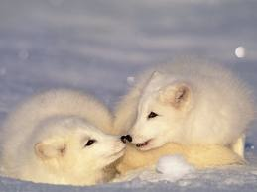
Arctic Foxes
By: Mackizee Stubbs

Slide 2
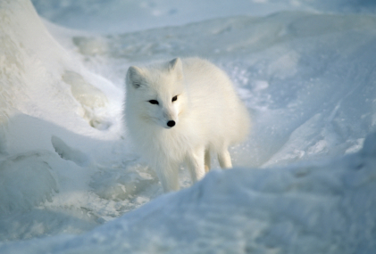
Body
All Arctic foxes are mammals.
Their thick fur keeps them warm.
A Arctic fox grows to 18 to 17 pounds and (8 kilograms)

Slide 3
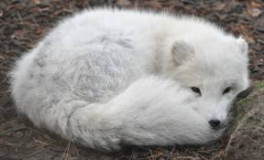
Habitat
Arctic foxes live near the North Pole .
This place is cold and snowy.
Arctic Foxes dig dens in the cold snow.

Slide 4
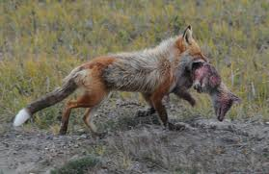
Food
Arctic Foxes are hunters and they are scavengers.
They eat fish, birds, and all other small animals.
Some Arctic foxes follow the polar bears they snack on the bears leftover food.

Slide 5
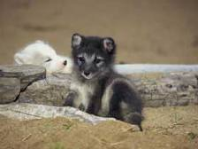
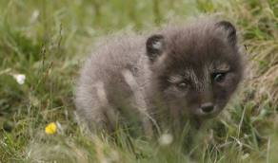
Life Cycle
All Arctic foxes mate in the early spring.
Females will give birth about 50 days later.
They have four to 11 kits Arctic foxes all live to six to 12 years in the wild.

Slide 6
Fun Facts
All Arctic foxes fur is white in the winter and their fur is brown in the summer.
Arctic foxes use their tail for their blankets when they sleep.
Arctic foxes al l have fur on their bottoms of their paws.

Slide 7
Reference
http://www.pebblego.com/content/animals/pgo_player.php

