Slide 1
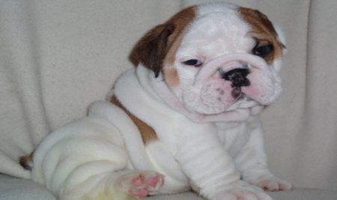
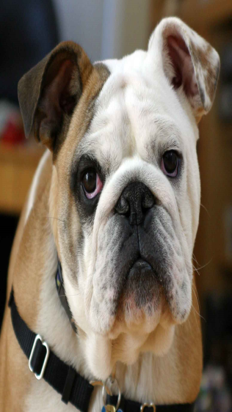
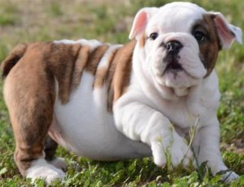
BULLDOGS
BY Mackenzie Ashlenden Williams

Slide 2
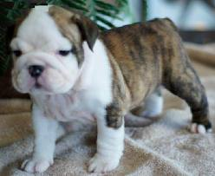
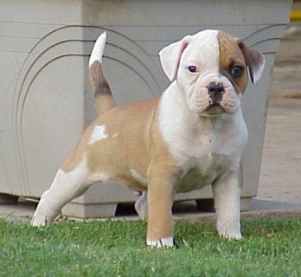
SIZE
The bulldogs size is 12 to 16 inches.
Adult bulldogs are 50 pounds and 23 kilograms.
Most bulldogs are short and wide.

Slide 3
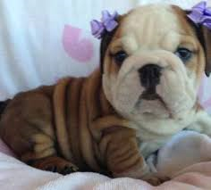
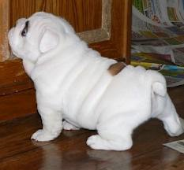
BODY
Here is a funny thing about bulldogs there head is to big for there body
A bulldogs natrol coloer is brown.

Slide 4
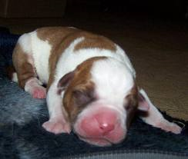
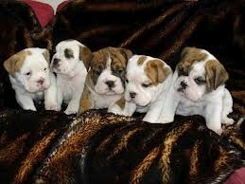
Life cycle
Bulldogs have four or five puppies in a litter
Some bulldogs live seven years or nine years to
Even like adult bulldogs puppies have big heads just like adult bulldogs to

Slide 5
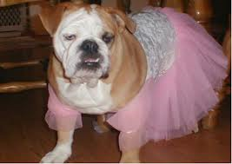
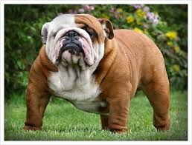
Care
Every day you should wipe bulldogs wrinkles
Bulldogs even need short walks to get fat off you don’t really want to run every day because it can hert the liver.
They often need food and water twice a day.

Slide 6
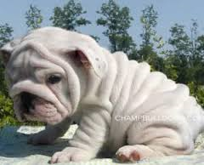
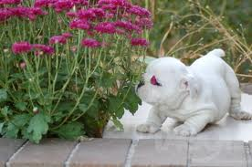
Fun facts
A lot of bulldogs have wide hips that make them wiggle when they walk.
Bulldogs snore to much sometimes .
Bulldog s have different color eyes they have black and brown.

Slide 7
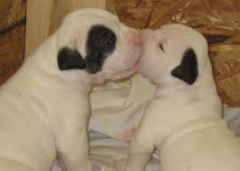
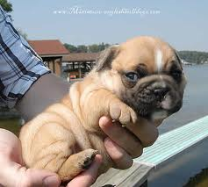
References
http://www.pebblego.com/content/animals/pgo_player.php

