Slide 1
Salamanders
By Lindsay Perkins

Slide 2
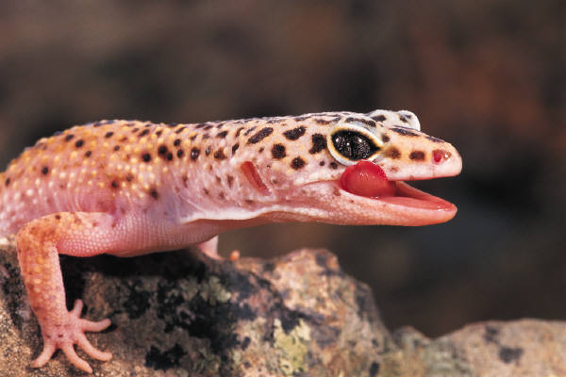
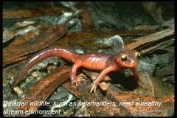
A Salamanders body
Salamanders are amphibians
They are known to be 4-6 inches
Salamanders use their long tails and short legs To walk and swim

Slide 3
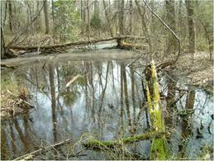
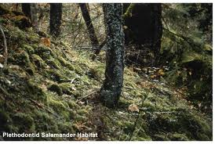
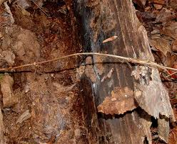
Salamanders habitat
Some salamanders live in water
Others may live in dark land like a rotten log
Most salamanders live in both land and water

Slide 4
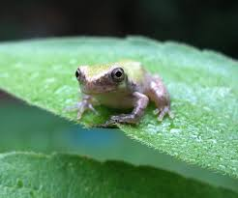
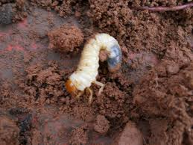
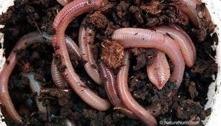
Salamanders food
Many salamanders are nocturnal and feast at night
They use their slimy tongues to catch their bugs and worms
Salamanders that live in water eat baby frogs

Slide 5
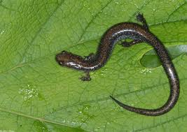
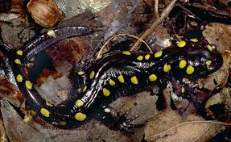
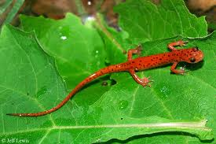
Salamanders life cycle
Baby salamanders are called larvae
They go through metamorphosis to become a grown up salamander
Some do this by loosing their gills and breathing fresh air

Slide 6
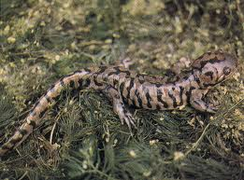
Fun Facts
Some salamanders can shed their tales
Most salamanders have poisonous skin
Chinese giant salamanders can be 6 feet tall

Slide 7
Reference Page
http://www.pebblego.com/content/animals/pgo_player.php

