Slide 1
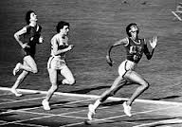
Wilma
By Lauren Presley

Slide 2
Introduction
No one believed that Wilma could do it they
Thought she was useless
Because of that dumb old polio made her leg cost.
She also was born June 23 in 1940 in Clarksville Tennessee.
Also scarlet fever AND polio cost the use of her leg poor girl.

Slide 3
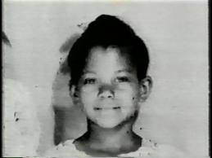
The days when she was little
That poor girl had to wear a brace on her left leg.
You know what the doctors said she may NEVER walk again!!!!
But worked and worked and worked to get better
Surprisingly by age 10 she could walk without the brace thank god that happened.

Slide 4
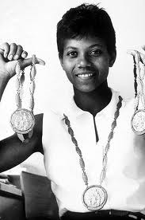
When she worked
At age 16 Wilma made it to the Olympics (track team)WOW!!!!! 16!!!!!
She won a bronze medal in 1960 Olympics games pretty cool
She won THREE GOLD MEDALS wow
Wilma was the first American (woman) to win three gold medals crazy right

Slide 5
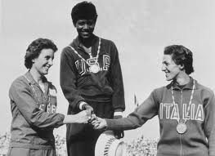
1994 years
Wilma graduated from Tennessee University
Then she got married she had 4 kids wow
Also she became a teacher a track coach and a T.V sports commenter
Then here is another sad part she died in 1994

Slide 6
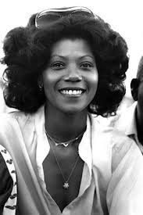
A Great person
Wilma was someone who never gave up
She was a great person maybe people have
never heard of Wilma but this story is not only about Wilma but its about believing in yourself

Slide 7
Contributions
So this story is something to in spire you .
Into a great person
to try and never give up

Slide 8
References
http://www.pebblego.com/content/biographies/pgo_player.php

