Slide 1
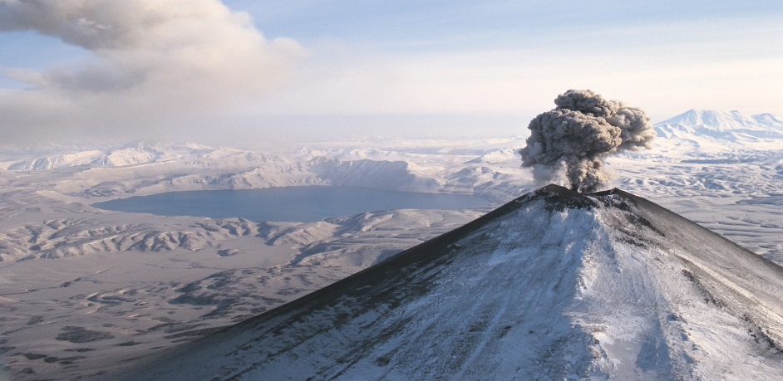

All about volcanoes!
Written by Landon Davis

Slide 2
What are volcanoes?
Volcanoes are holes in Earth’s surface.
Most of them look like mountains. A few of them are low and flat.
When volcanoes erupt, they send out gas, lava, and ash.

Slide 3
What causes Volcanoes?
Pressure builds up inside the Earth’s surface.
Magma or lava are pushed up to the top of the volcano. Then the volcano erupts.
The lava or Magma flows down the side of the volcano a few seconds after it erupts.

Slide 4
Volcano damage
Dust and ash fill the air. They cover miles around the volcano.
Volcanoes can cause landslides or earthquakes.
Sometimes they destroy buildings and crops.

Slide 5
Where are they?
Most Volcanoes form near the edges of continents.
Many Volcanoes make a ring of fire.
Some Volcanoes are located at the bottom of oceans.

Slide 6
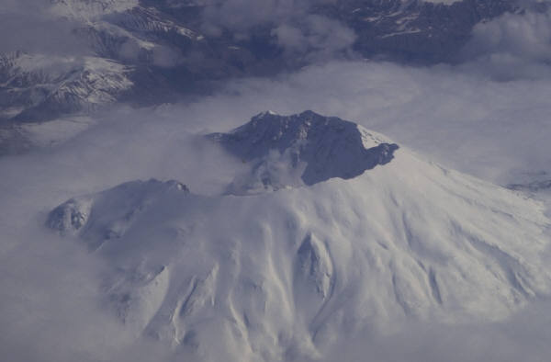
Studying Volcanoes
Scientists watch the activity of Volcanoes to predict when it will erupt.
People can be warned to leave the area to stay safe of the Volcano.

Slide 7
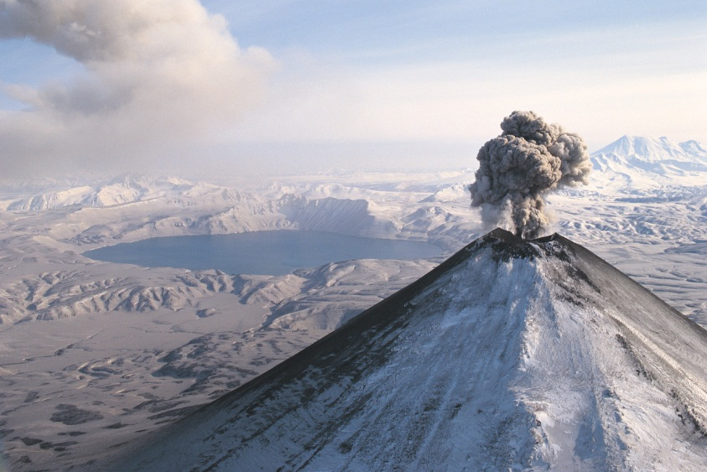
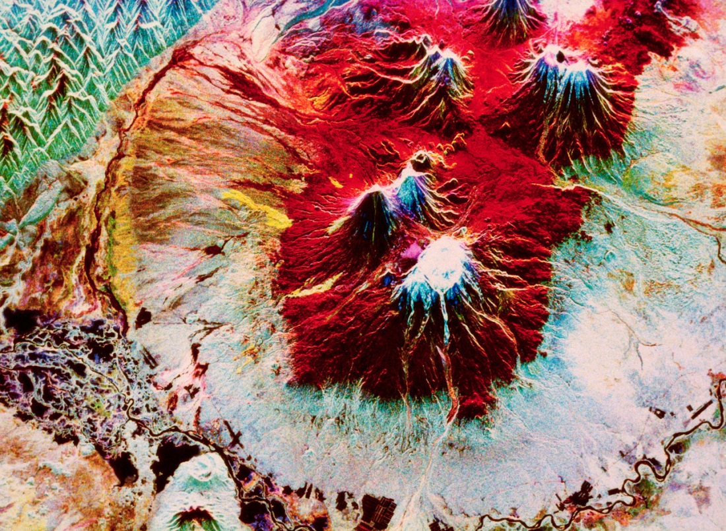
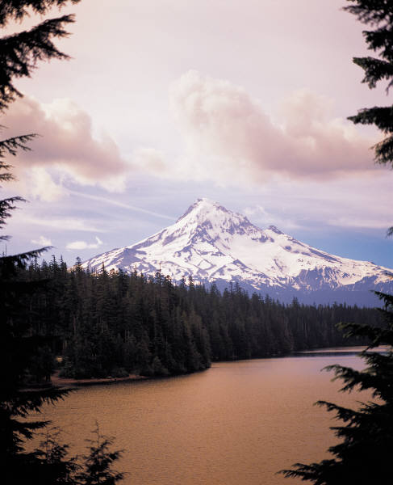
What volcanoes look like

Slide 8
References
http://www.pebblego.com/content/science/pgo_player.php

Slide 9
About the athour.
Landon Davis is a 9 year old with 1 cat and no siblings. He lives in Springfield Missouri. He has a mom and a dad and lots of great friends.

Slide 10
Glossary
Ring of fire-a circle of volcanoes
Ash-a cemicel that is dirty in the air
Magma-a nother name for lava.
Lava-a very hot liquid that comes out of volcanoes.

