Slide 1
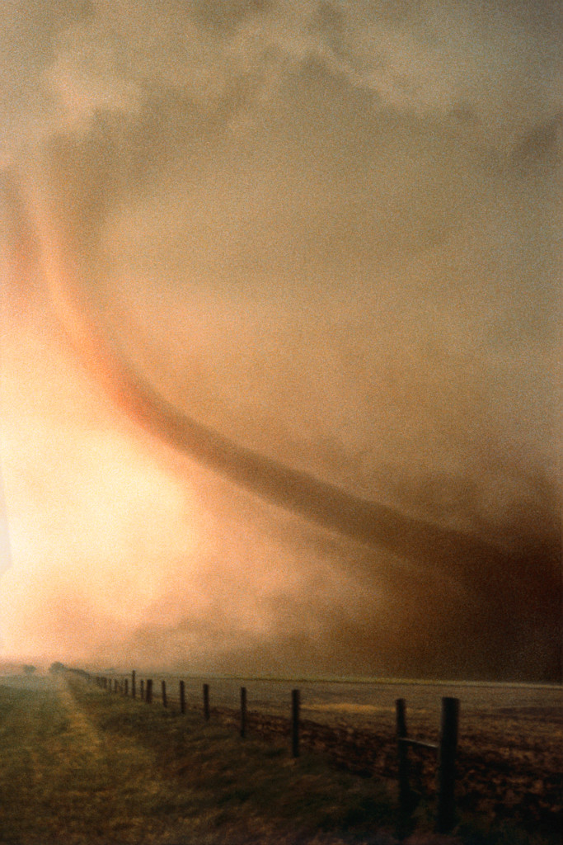
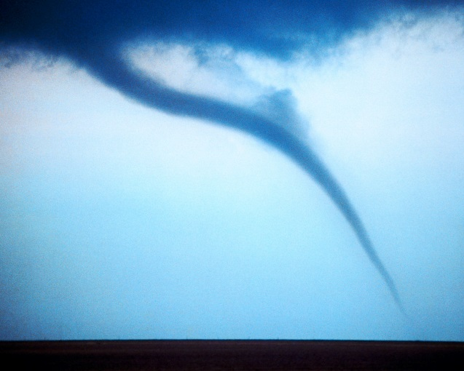
Tornados
By Kessler

Slide 2
What Are They
Tornados are a swirling funnel.
When warm and cold weather meet a tornado is formed.
When tornados touch the ground it is officially a tornado.

Slide 3
How Do They Happen?
In Spring or Summer Tornados happen
When warm and cold weather meet tornados are formed.
Then they move along very fast as they go.

Slide 4
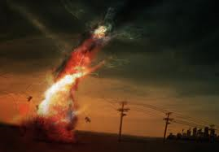
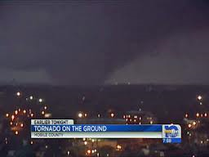
Where Do They Happen
Tornados happen all over the world.
They normally happen in Tornado Alley
The Tornado Alley is in the central United States

Slide 5
What Do They Do?
Tornados do a lot damage to houses, and buildings.
Tornados destroy anything in their path.
They also uproot trees

Slide 6
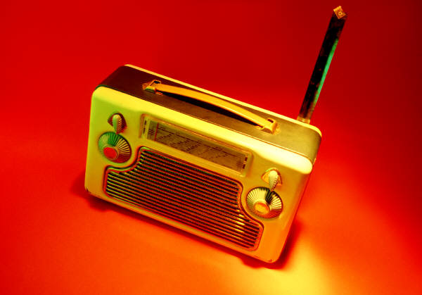
Tornado Safety
If you are outside go to the closest ditch
If you hear sirens going off outside then get some blankets and go to a windowless room.
When you are down in the basement listen to the radio.

Slide 7
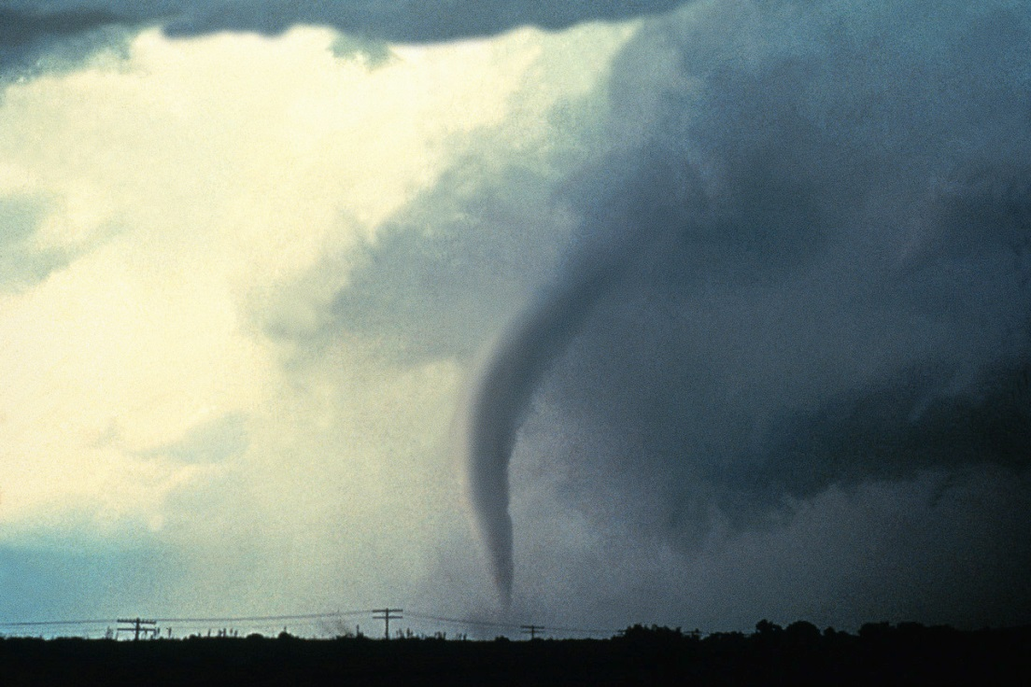
Reference
http://www.pebblego.com/content/science/pgo_player.php

