Slide 1
piranhas
by: Jonathan Ellerman

Slide 2
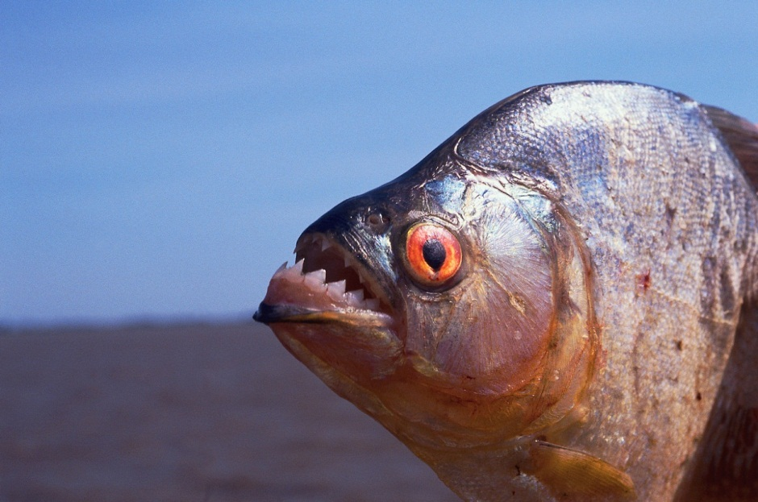
body
Piranhasare are smalle hunters.
They are about a foot long.
They are coverd with shiny scales.

Slide 3
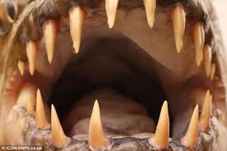
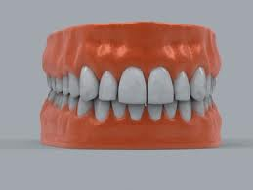
These are piranha teeth.
teeth
They are very diffrent.
This is human teeth.

Slide 4
Life cycle
They can lay about 5,000 eggs.
Three days they will hatch.
After two years they are full grown.

Slide 5
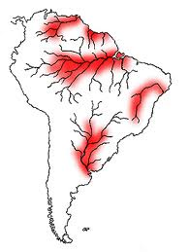
Most piranhas live in south america. They live in tropical rivers. Piranhas often swim near shore to find food.
Where piranhas live

Slide 6
About 20 types of piranhas live in south america. Piranhas often swim in schools to stay safe. Some people keep piranhas as pets.
Fun fact!

Slide 7
http://www.pebblego.com/content/animals/pgo_player.php
references

