Slide 1

X-TREME WEATHER
By Jeffrey Harkey

Slide 2
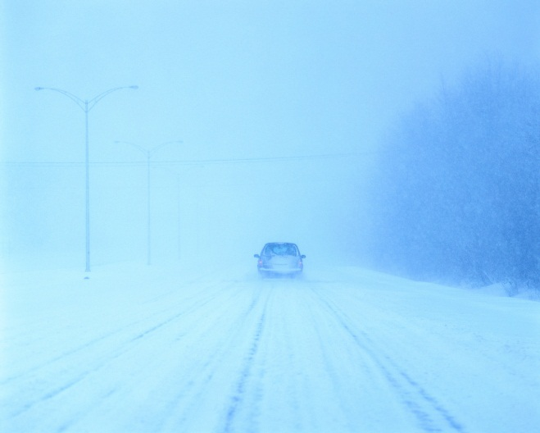
Blizzards
They are very cold.
There are winds of at least 35 miles per hour.
They start when a front of cold air and warm air meet in winter.
A lot of snow starts to fall and strong winds come with it.
It is very dangerous.
Stay inside during a blizzard to stay safe.

Slide 3
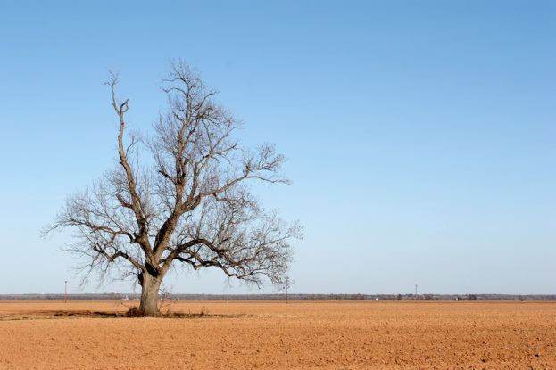
Drought
They happen when there is not enough rain.
They happen in grasslands, plains, and desert areas.
Wind pushes away the rain.
Everyone has less to eat.

Slide 4
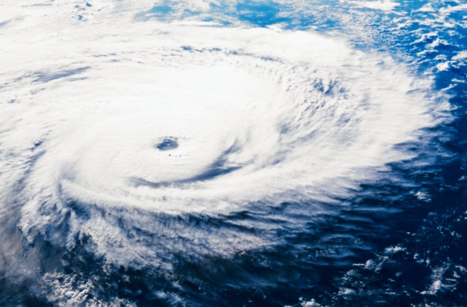
Hurricanes
These are like tropical tornadoes that happen in the ocean.
They are basically surrounded by thunderstorms.
The eye of the storm is calm.

Slide 5
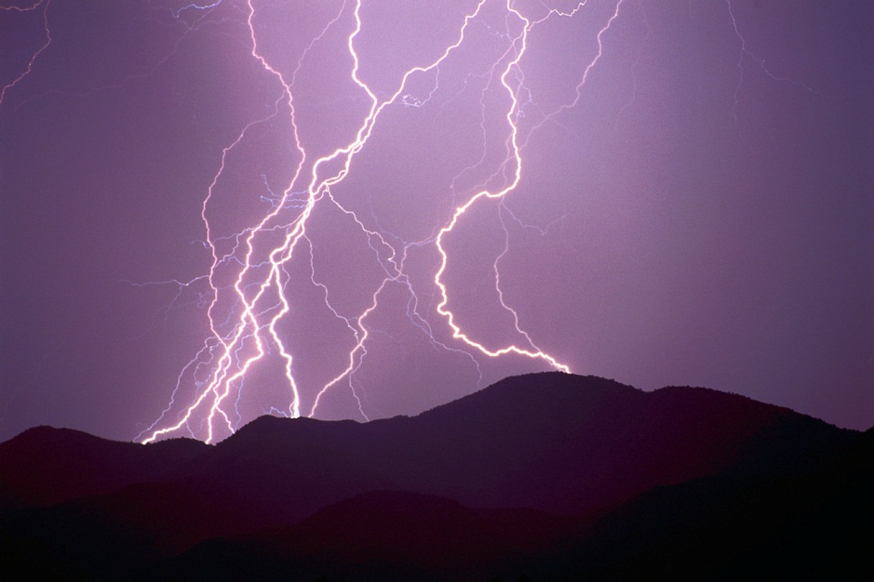
Lightning and Thunder
Lightning is made by ice moving very fast in the sky.
Thunder and lightning happen at the same time. Light goes faster than sound.
Lightning is very dangerous.

Slide 6
Thunderstorms
These are storms with thunder and lightning.
Thunderstorms can start fires and produce hail.
These are powerful.

Slide 7
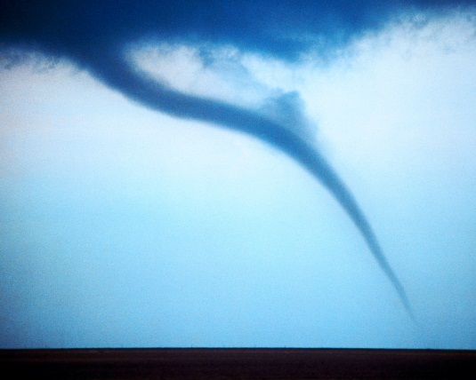
Tornadoes
This is a swirl of fast wind.
Cold air visits warm air sometimes. They fight and basically create the tornado.
We are in a place called Tornado Alley.

Slide 8
References
http://www.pebblego.com/content/science/pgo_player.php

