Slide 1
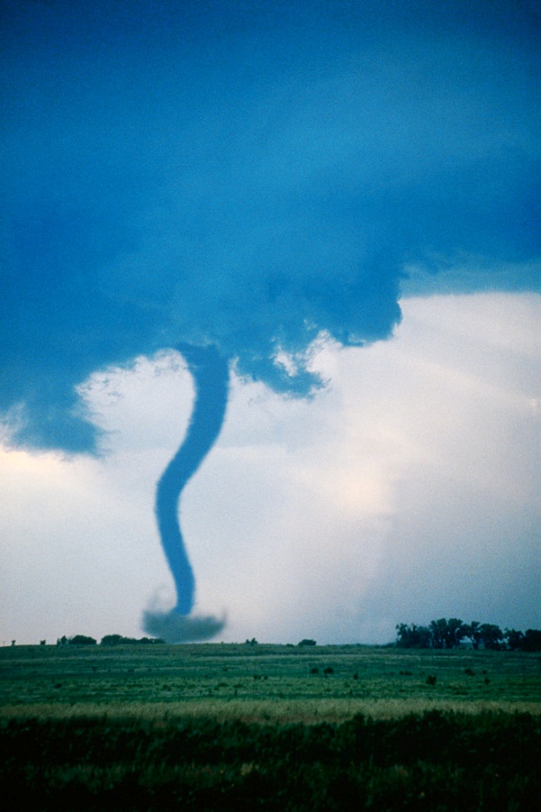
Tornados
By Javier

Slide 2
Table of contents
What are they
How do they happen
Where do they happen
What do they do

Slide 3
What are they
A tornado is a funnel of wind
There very strong
It’s a tornado if it hits the ground

Slide 4
How do they happen
Tornados happen in spring and summer storms
When warm air meets cold air
Turns into funnel cloud

Slide 5
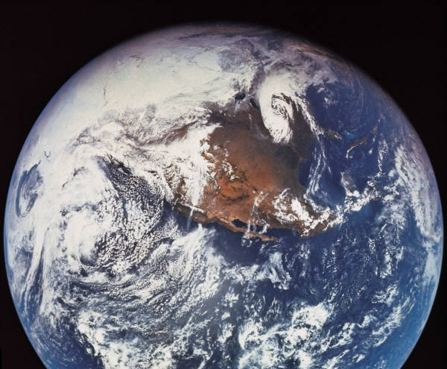
Where do they happen
They happen in the tornado alley
Mostly in central united states
All over the world

Slide 6
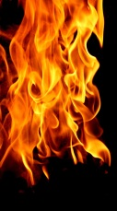
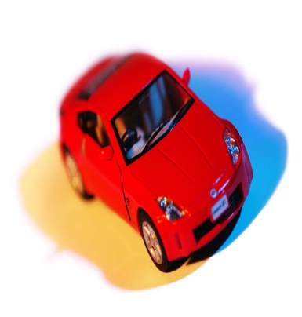
What do they do
Destroys everything in its path
Breaks buildings
Blows up cars

Slide 7
Reference
http://www.pebblego.com/content/science/pgo_player.php

