Slide 1
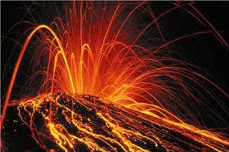
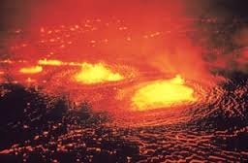
Volcanoes
By Jake Caudill

Slide 2
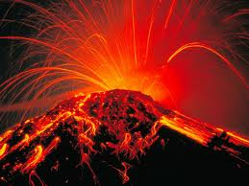
What Are They?
A volcano is a opening in Earth’s surface.
Sometimes they look like mountains and sometimes they are flat and low.
When they erupt they send hot lava and rocks.

Slide 3
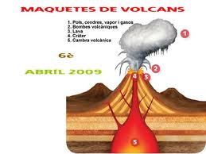
What Causes Them?
When pressure builds up inside the Earth it’s pushed to the surface.
The lava is pushed out the volcano and into the open world.
When it reaches the surface it’s called lava and then it starts to floes down the volcano.

Slide 4
Volcano Damage
When volcanos erupt ash and dust fill the air.
The ash and dust cover everything for miles around the volcano.
Sometimes volcanos can cause earthquakes or landslides.

Slide 5
Were Are They?
A lot of volcanos are near the Pacific Ocean.
When they are like this they are called The Ring of Fire.
Some times volcanos are at the bottom of the ocean.

Slide 6
Studying Volcanoes
Some scientists study and watch volcanos.
They measure volcano activity.
They try to predict when they’re going to erupt.

Slide 7
Reference
http://www.pebblego.com/content/science/pgo_player.php

