Slide 1
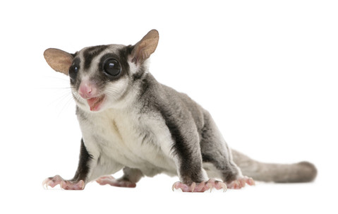
Sugar Gliders
By Jada Holloman

Slide 2
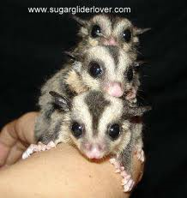
Body
Sugar gliders are marsupial they have gray furry long tails.
It weighs about 4 to 6 ounces
Flaps of skin join the hands and the feet.

Slide 3
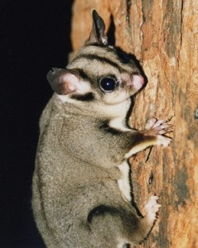
habitat
Sugar gliders are living in the trees of Australia
They can lead of high branches
When a predator is after a sugar glider their flaps open there sink so they can get away

Slide 4
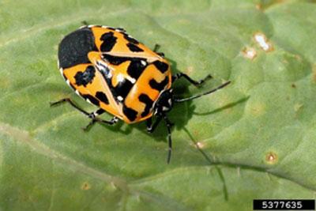
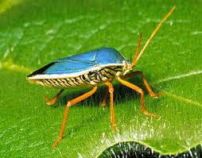
Food
Sugar swoop throw tree at night
They catch bugs to eat
Sugar gliders eat many things that are sweet

Slide 5
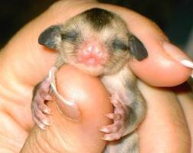
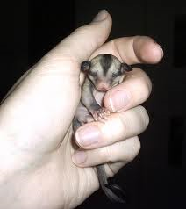
Life cycle
Sugar gliders do not live long only 9 years.
Mother sugar gliders have pouches
In months 10 mouths it is all grown up

Slide 6
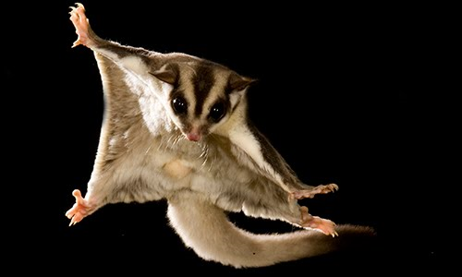
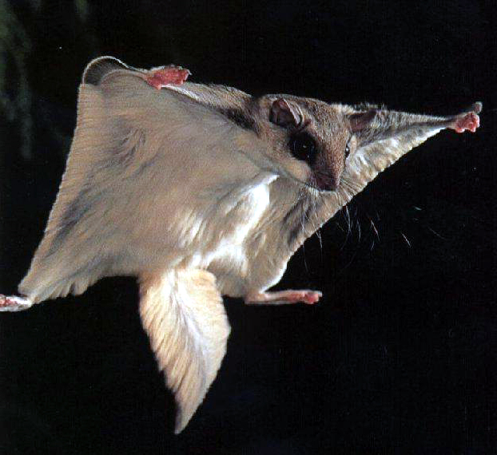
Fun facts
A sugar gliders call is like a bird and a dogs
When a group of sugar gliders is scared the sugar glider chatter loudly
They can go more then 165 feet

Slide 7
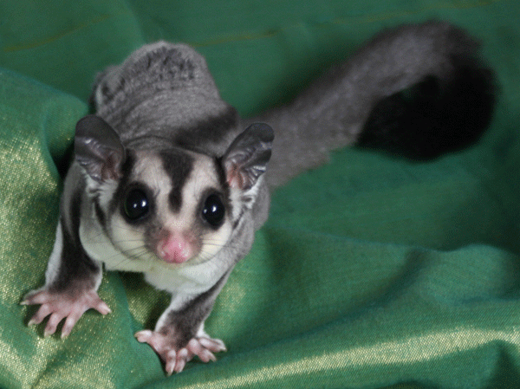
Reference
http://www.pebblego.com/content/animals/pgo_player.php

