Slide 1
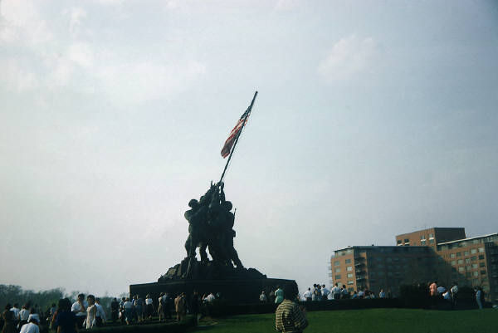
veterans day
By Jacob

Slide 2
What is veterans day
Veterans day is on November 11
They honor veterans
Veterans get honor

Slide 3
Veterans share there story
Veterans share a story
They help people
They work in the military

Slide 4
Veterans day
Veterans day has a parade
It has veterans speeches
They fly flags

Slide 5
Thankful for veterans
Veterans die in war
They serve the country
You say thank you to veterans

Slide 6
The first veterans day
You celebrate veterans day
It was named by president dwight
It was named in 1954

Slide 7
References
http://www.pebblego.com/content/socialstudies/pgo_player.php

