Slide 1

The scary and deadly spiders a insect and a wild cat
By Hayden

Slide 2
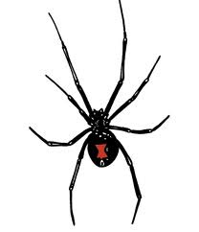
Black widows defense and body
Black widows have silky black body and a big red hour glass on it’s stomach.
The red mark on the stomach warns predators not to eat them
Black widows are poisonous only the female bites
The female is bigger than the male
There name comes from killing there mates when a women loses her husband by death

Slide 3
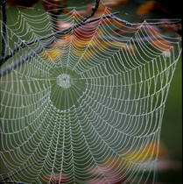
Black widow habitat and food
Black widow live in warm places like barns, beaches, garages even your car
Black widows spin webs in warm corners
Black widows spin big webs
Black widows eat insectes
Blake widows also eat centipedes, scorpions, and there mates

Slide 4
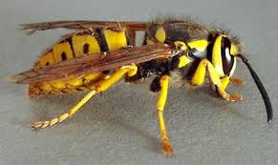
Yellow jackets food
Yellow jackets have a vertical mouths and eat other insects
They sting other insects then eat them with their vertical mouths

Slide 5
Yellow jackets body
Yellow jackets have a stinger at the end of their body they use it when it is necessary. The sting is black an yellow
They a have a small body that holds the head, stinger, wings and legs

Slide 6
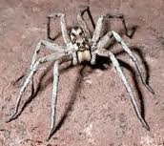
Wolf spiders food
Wolf spiders eat insects and probably what the black widows eat
They got big jaws to crush their prey

Slide 7
Wolf spiders body
The wolf spider has a head that contains eight eyes two jaws and four legs
The spider’s back contains four legs

Slide 8
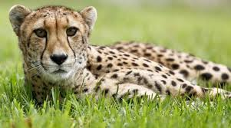
Cheetahs food
Cheetahs eat herbivores [ herbivores eat plants]
They also are getting to be instinked

Slide 9
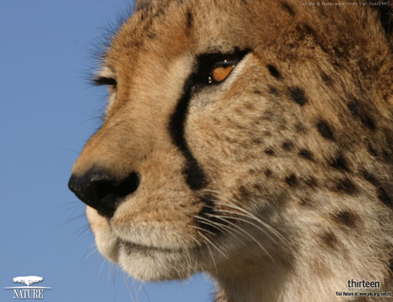
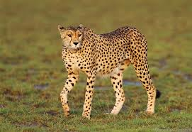
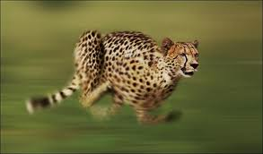
Cheetahs body
The cheetah has fast feet so they can catch prey
They also have nice fur that people hunt for

Slide 10

References
http://www.pebblego.com/login.php

