Slide 1
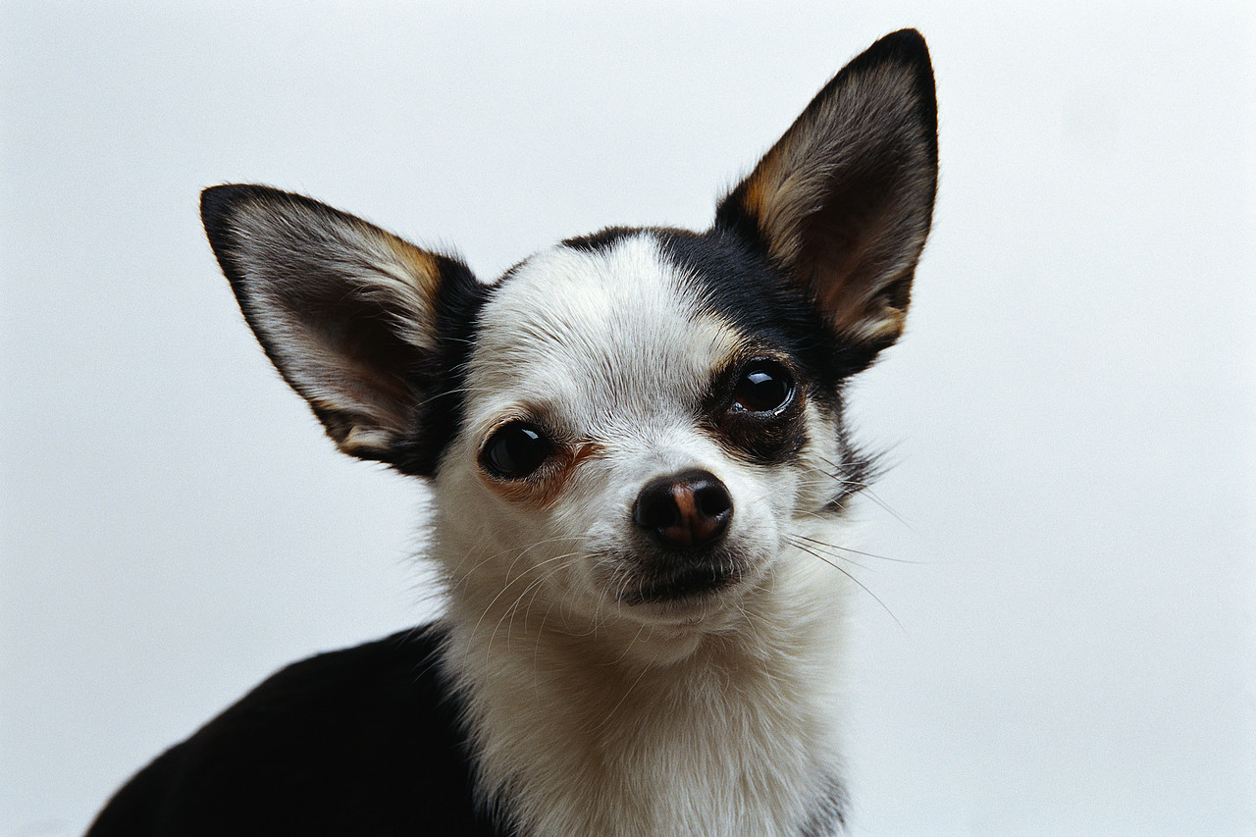
Chihuahuas
By Haille

Slide 2
Size
Chihuahuas are a smaller breed
Chihuahuas weigh to 2 and 6 pounds

Slide 3
Body
Chihuahuas have different hair cuts like long and short hair.
Chihuahuas can be black, white, cream, or tan.
Brindle chihuahuas have more than one hair color.

Slide 4
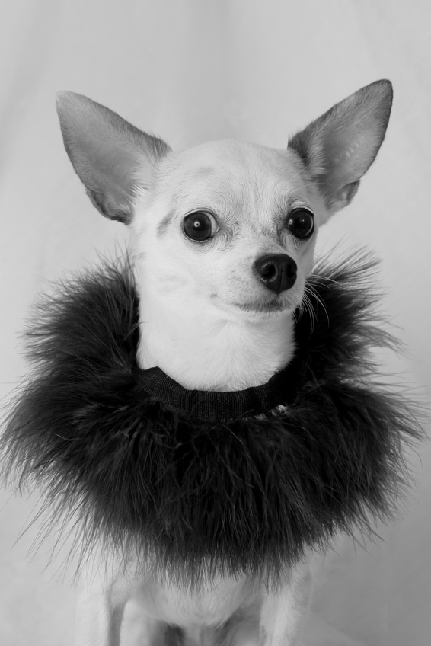
Life cycle
Female Chihuahuas give birth to three to six puppies.
They are adults after 6 to 18 months.
Chihuahuas live for 12 to 15 years.

Slide 5
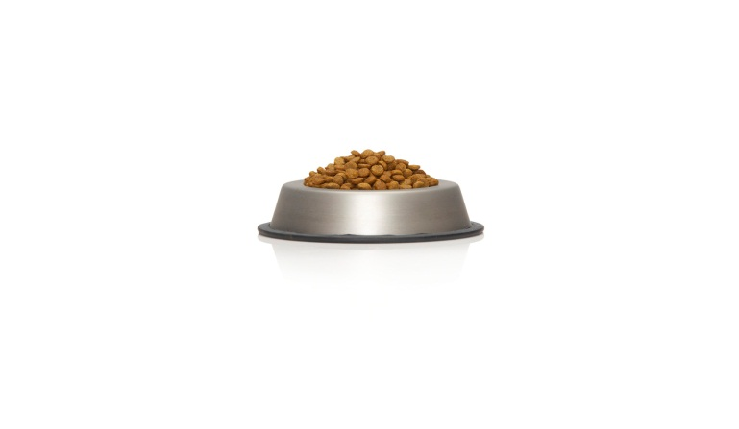
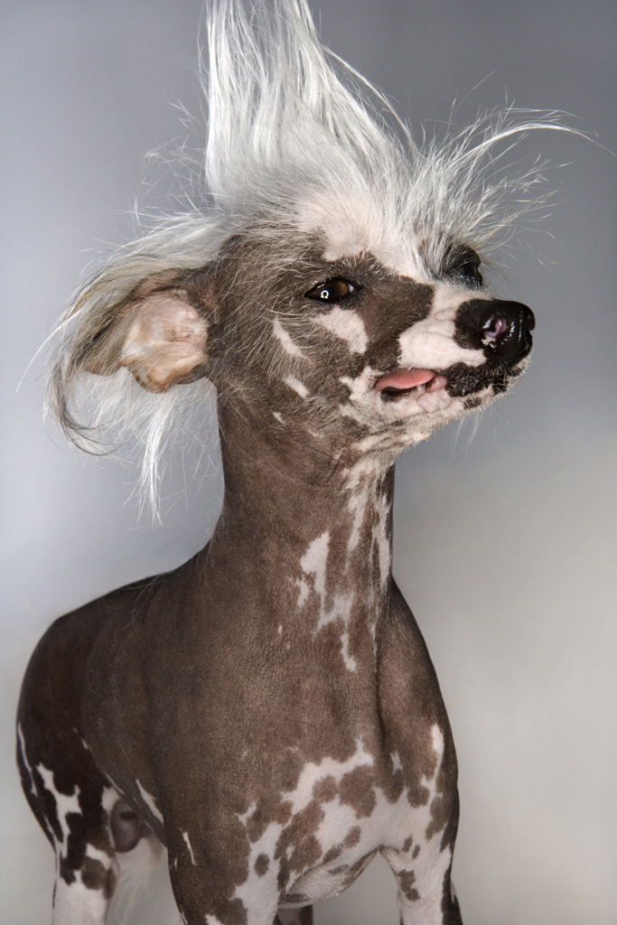
Care
Owners care for Chihuahuas.
They feed them twice a day.
They also need to be brushed to keep their coats clean and shiny.

Slide 6
Fun facts
Chihuahuas shiver when they are exited or cold.
Chihuahuas are named after states in Mexico.
Chihuahuas and other small breeds are called toy breeds.

Slide 7
References
http://www.pebblego.com/content/animals/pgo_player.php

