Slide 1


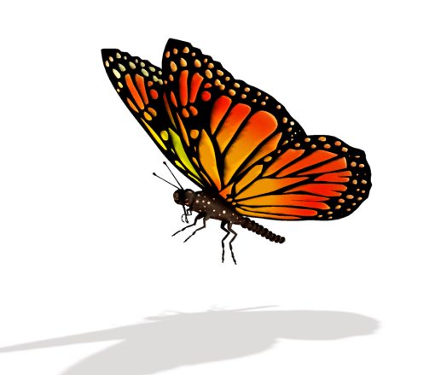
Monarch Butterflies
By Gabriel

Slide 2

Body
Monarch Butterflies are insects.
They have to antennae on they’re heads.
They have a wingspan of 4 inches.

Slide 3

Habitat
Monarch Butterflies fly to Mexico for winter.
They need above 60 degrees.
They live in meadows and fields.

Slide 4
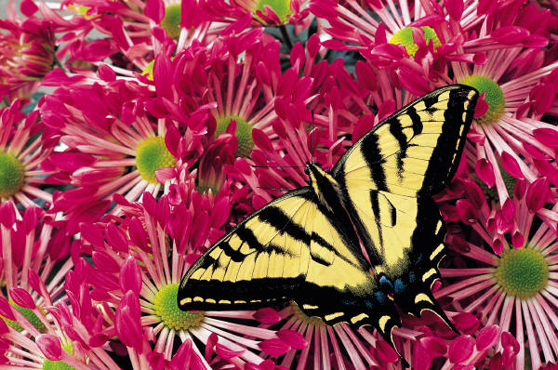
Food
Monarch Butterflies have a long tongue called a proboscis.
They drink nectar from flowers.
Monarch larvae called caterpillars eat milkweed plants.

Slide 5
Life cycle
Monarch larvae hatch from eggs.
In two weeks larvae from chrysalises.
Inside they become pupae in two week thy are adults.

Slide 6
Fun fact
Monarch Butterflies use wind to travel.
Monarch can taste things with they’re legs.
Monarch eggs take four days to hatch.

Slide 7
Reference
http://www.pebblego.com/content/animals/pgo_player.php

