Slide 1
MEGALODON
By Ethan. P

Slide 2
Body!
The Megalodon is at least 50 feet long.
The Megalodons teeth were as sharp as any thing you can imagine.
Not to worry the Megalodon is prehistoric.

Slide 3
Habitat
Megalodons lived 30 million years ago.
They lived in oceans all over the world.
Now don’t worry they don’t live in these oceans anymore

Slide 4
FOOD!!!!
The Megalodons ate whales yes I said whales!!!
They bit their food in chunks with teeth sharper than knives.

Slide 5
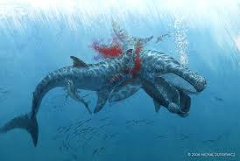
References
http://www.pebblego.com/content/animals/pgo_player.php

