Slide 1
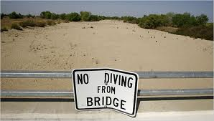
Drought
By Eric Smart

Slide 2
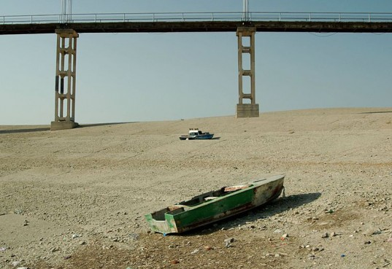
What is Drought?
A Drought happens when there is not enough precipitation in the area.
Crops dry up and die.
Lakes and rivers may also dry up in a severe drought.

Slide 3
Die or Drought
Dry weather and Drought are different.
A place may have less rain or snow than usual for a few weeks.
But drought happens when very dry weather lasts many months longer.

Slide 4
Where Do They Happen?
Droughts may Happen anywhere.
But droughts hit desert areas most.
Grasslands and plains also have droughts, crops grow on plains so, droughts leave people with little food.

Slide 5
What about winds
Every area has usual wind patterns, if these winds change, weather changes.
Winds may push away storms.

Slide 6
Effects of Drought
Droughts make it hard to get clean water because shrinking holes fill with bacteria.
Crops stop growing and end up dying.
People and animals have less to eat.

Slide 7
References
http://www.pebblego.com/content/science/pgo_player.php

