Slide 1
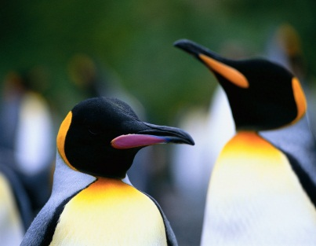
King Penguins
By Eric Anderson

Slide 2
Body
King Penguins swim.
Their wings are their flippers.
They are 3 feet tall and have orange feathers on their chest and ears.

Slide 3
King Penguin Habitat
King Penguins live on islands.
They live on islands around Antarctica.
They live in colonies in valleys or beaches on those islands.

Slide 4
What King Penguins Eat
King Penguins eat fish.
They also eat other small sea animals.
To get their food they have to dive very deep down into the ocean.

Slide 5
A King Penguin’s Life Cycle
The females lay one egg.
The parents take turns carrying the egg with their feet.
The chicks hatch 55 days later.

Slide 6
“Cool” Facts
The king penguin is the second largest penguin.
There are 2 million king penguins currently in the world now.
They can hold their breath for three minutes.

Slide 7
References
http://www.pebblego.com/content/animals/pgo_player.php

