Slide 1
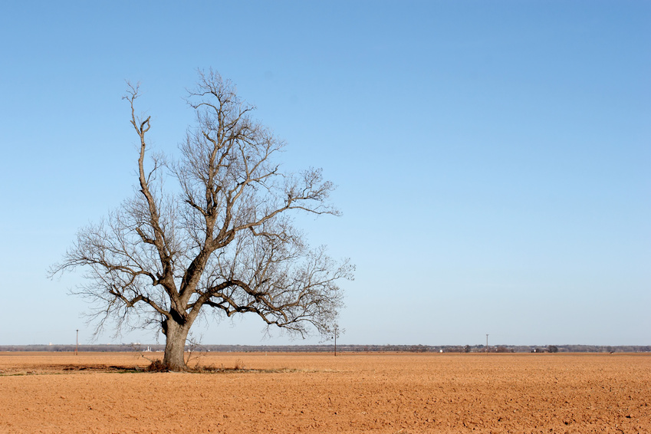

Droughts
By: Emma Hartman

Slide 2
What are They?
Drought create whenever there is not enough precipitation in an area.
Crops dry up and eventually they die.
Lakes and rivers may also dry up in a very bad severe drought.

Slide 3
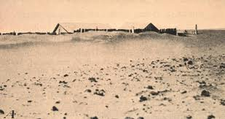
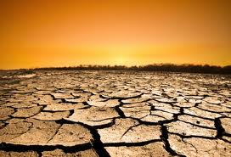
Dry or Drought?
Dry weather and droughts are two different things.
Some places may have less rain or snow than usual.
But droughts happen when very dry weather lasts a long while.

Slide 4
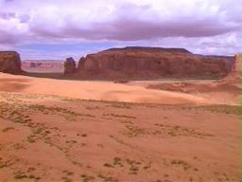
Where do they Happen?
Droughts can happen anywhere.
But droughts hit desert areas most.
Grasslands and plains also have droughts.
Crops grow on plains so if there are droughts there they leave people with barely any food.

Slide 5
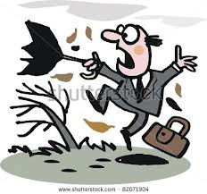
What about Wind?
Every place in the world has wind patterns.
If they change, weather changes.
Winds push away storms or keeps clouds from forming.
Then rain doesn’t fall and droughts start to happen.

Slide 6
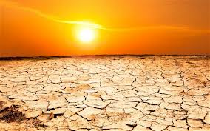
Effects of Droughts
Droughts make it hard to get fresh, clean water.
Shrinking watering holes fill up with harmful bacteria.
Crops stop growing and die.
People and animals have less to eat.

Slide 7
References
http://www.pebblego.com/content/science/pgo_player.php

