Slide 1
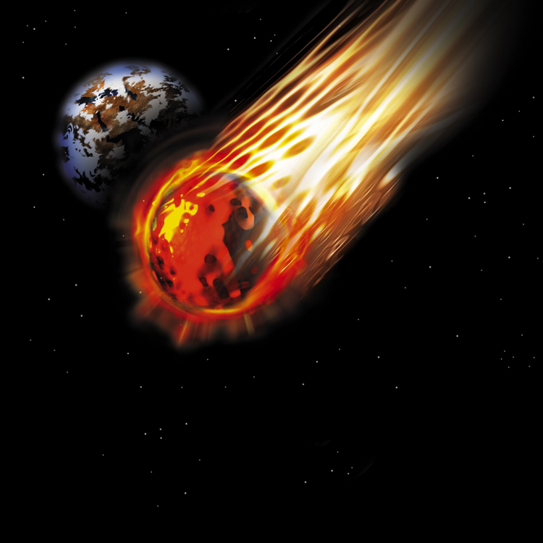
Deep space
By Elijah Colston

Slide 2
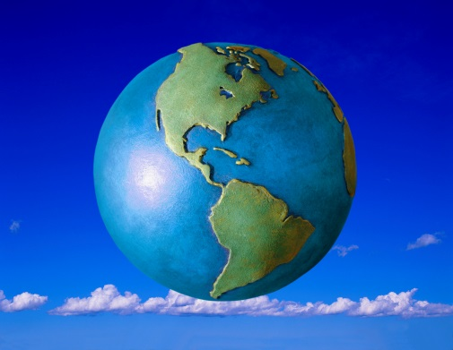
Planets!!!
Planets are spheres of rock or ice.
They do not emit rays of light yet they reflect light and use it.
Every planet orbits a star.

Slide 3
Solar System
First comes Mercury, Venus, Earth, Mars, Jupiter, Saturn, Uranus, Neptune
I did not mention Pluto, for, Pluto is a dwarf planet.
Not an old man planet.
I’m a planet!!!

Slide 4
Star Light Night
The sun is a star.
Stars explode into life, glad we don’t!!!
Stars are huge balls of gasses.

Slide 5
Space Shuttles
A space shuttle is a vehicle.
They are propelled by fire.
The pressure of space does not effect it.

Slide 6
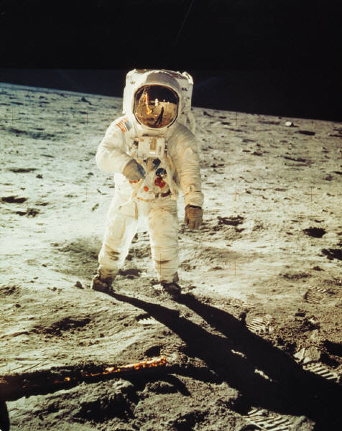
Astronauts
Astronauts are people working in space.
They have different jobs.
Some are scientists or pilots.

Slide 7
References
http://www.pebblego.com/content/science/pgo_player.php

