Slide 1
Coupon Book
For mom and Dad
FROM
Bethany

Slide 2
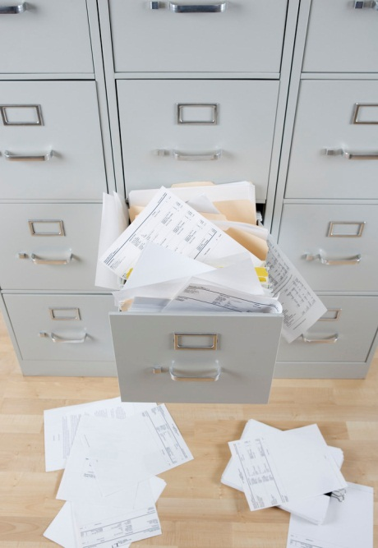
Dot make a mess.

Slide 3
Get the mail for a moth

Slide 4
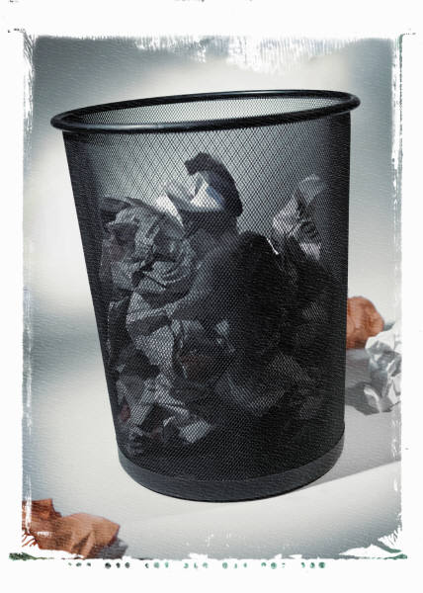
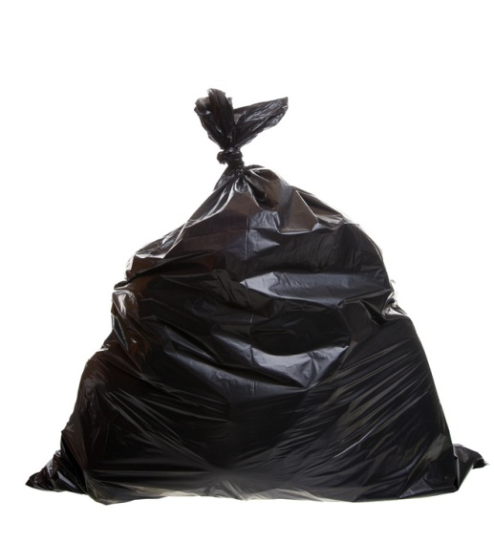
to take out the trash for a week

