Slide 1
Black widow spiders
By Chris

Slide 2
Body
Black widow’s have a red picture on bellies

Slide 3
Habitat
Black widow spiders live in warm places around
The world

Slide 4
food
Bugs
insects

Slide 5
Lifecycle
They don’t hatch for about two years

Slide 6
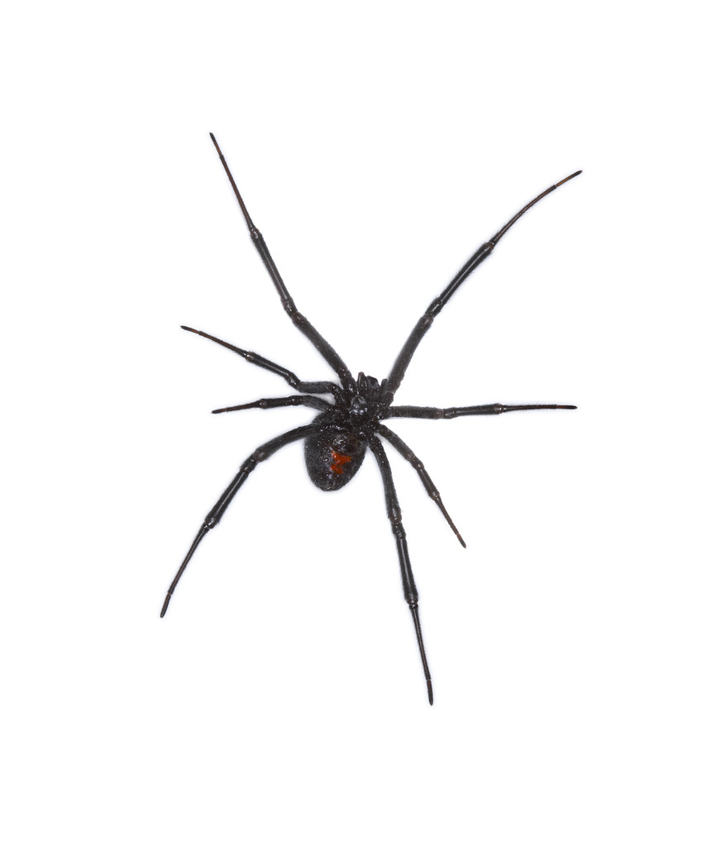
Fun facts
New spiders are called spider lings
The red mark

Slide 7
references
http://www.pebblego.com/content/choose_product.php

