Slide 1
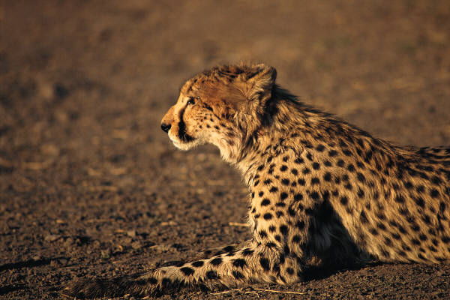
Cheetahs
By Cheyenne

Slide 2
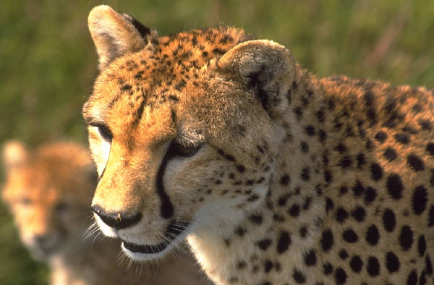
Body
Cheetahs fur is tan or brown.
Cheetahs can be up to 7 feet long.
Cheetahs are wild cats that don’t live indoors.

Slide 3
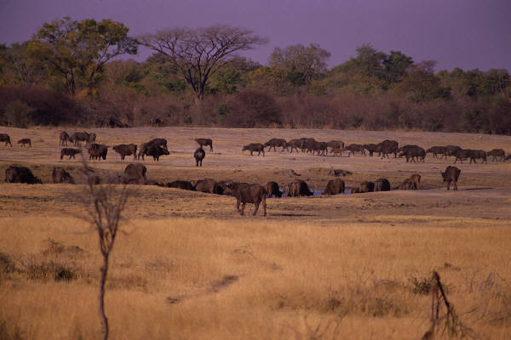
Habitat
Some cheetahs live in Africa and some live in Asia.
Cheetahs roam grassy areas.
Some cheetahs live in a savanna.

Slide 4
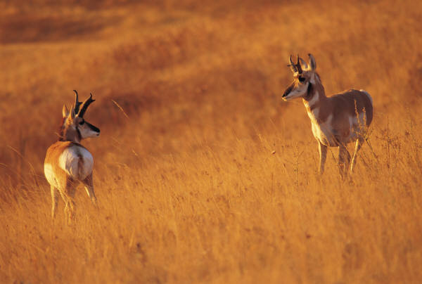
Food
Cheetahs run as fast as 70 miles pure hour.
There speed helps them catch food.
Like antelope.

Slide 5
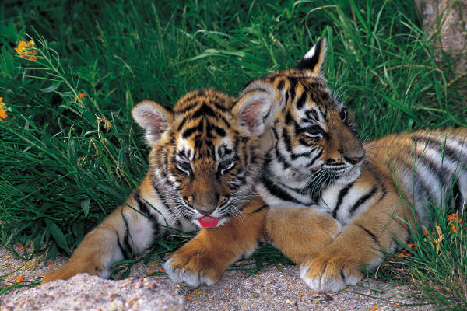
Life Cycle
Some female cheetahs give birth to three to five cubs.
Cheetahs live in the wild.
They are able to live in the wild place from 10 to 12 years.

Slide 6
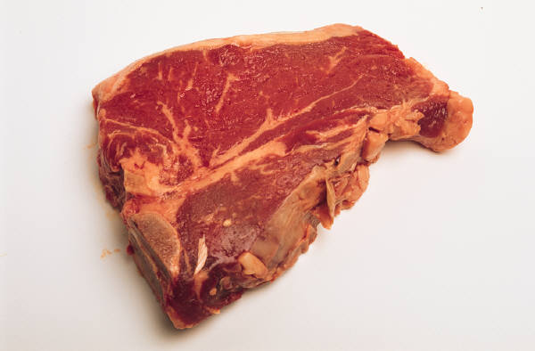
Fun Facts
Females chirp to call cubs
Cheetahs hunt during the day
Some cheetahs have black strips

Slide 7
Reference
http://www.pebblego.com/content/animals/pgo_player.php

