Slide 1
The solar system
By. Brody Whitman

Slide 2
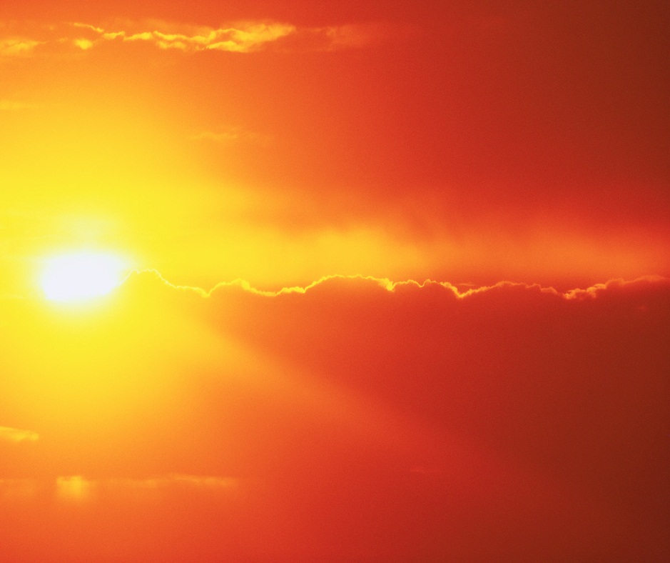
The sun
The sun is a big star in the sinter of the solar system it’s what makes gravity

Slide 3
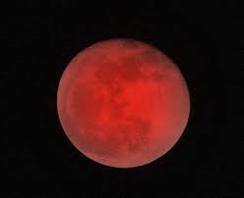
mercury
Mercury is the hoist planet in the universe
It is 28.8 miles away from the sun.
Mercury is 430 °C

Slide 4
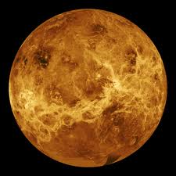
Venus
Venus is .108 million km away from the sun.
It is the second hottest planet in the universe
Venus is 462 degrees Celsius.

Slide 5
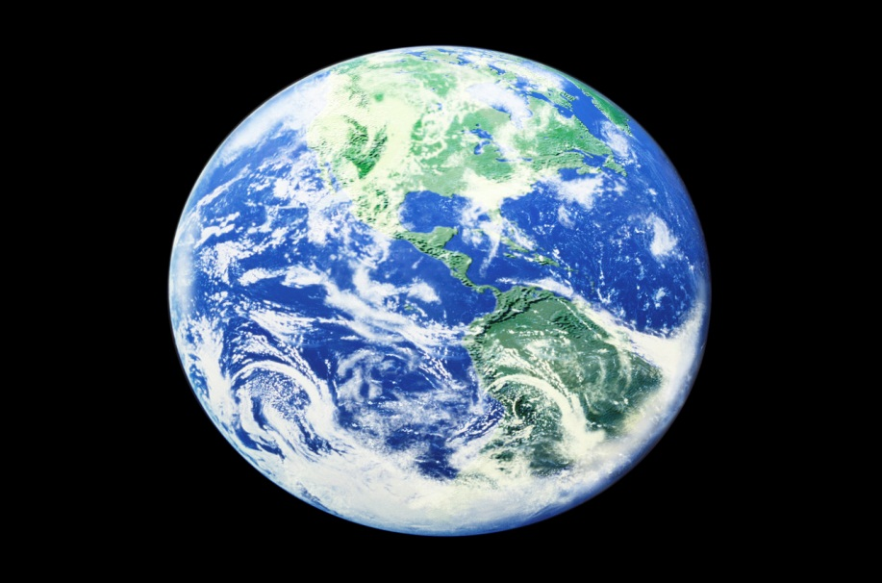
Erath
Erath is the only planet we know that has life on it.

Slide 6
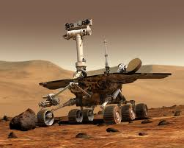
mars
Scientist have relished a camera on mars to see if aliens or martins live their.

Slide 7
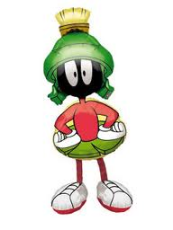
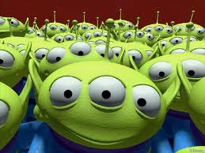
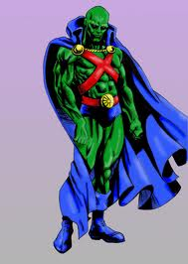
Mars facts
A famous marshians is marshianman hunter
Mars has over 100 marshinens characters like
Marshine man hunter and Marvin the marshine man

Slide 8
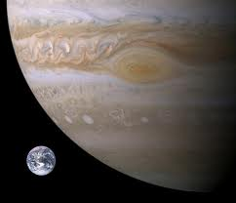
Jupiter
Jupiter is the biggest planet in the solar system (the sun is not a planet)

Slide 9
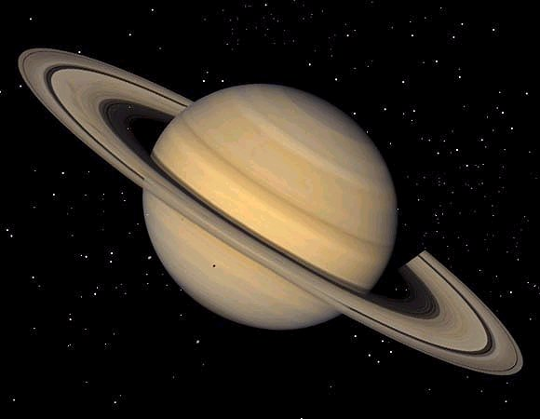
Saturn
Saturn is the second biggest planet in the solar system

Slide 10
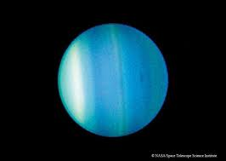
Uranus
Uranus has 27 moons

Slide 11
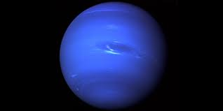
Neptune
Neptune is made from gas and clounds

Slide 12
My infirmities came from
http://www.pebblego.com/content/science/pgo_player.php

