Slide 1
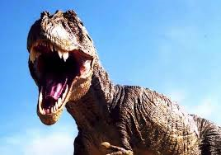
Tyrannosaurus Rex
By Brenden

Slide 2
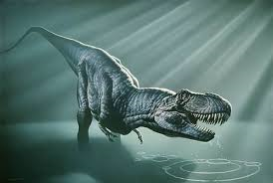
body
Tyrannosaurs Rex are 18 feet tall
They have sharp claws
They have big heads

Slide 3
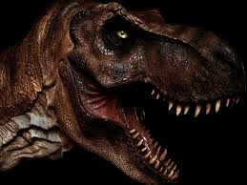
habitat
The t-rex lived 70 million yeas ago
It lived in north America
It lived in wood lands

Slide 4
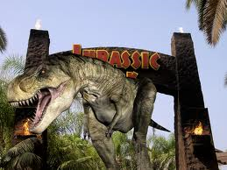
food
Meat
Other dinosaurs
Eats animals that are dead

Slide 5
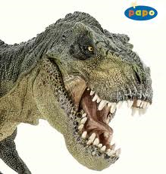
behavior
It is a predator
It is a scavenger
Spends most of time hunting

Slide 6
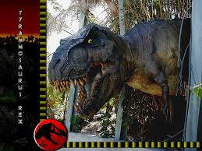
Fun facts
The word tyrannosaurus rex means king tyrant reptile
Used tail for balance
Extinct 65 million years ago

Slide 7
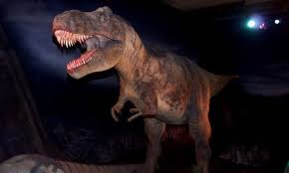
Reference
http://www.pebblego.com/content/animals/pgo_player.php

