Slide 1
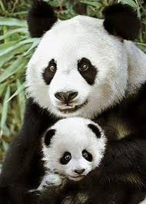
Giant Pandas
By Brandon Graef

Slide 2
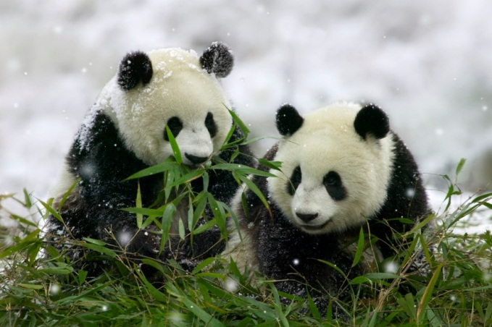
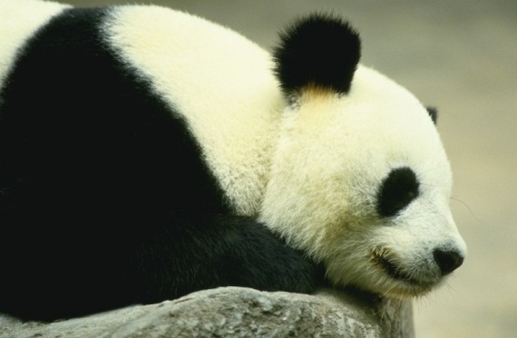
Body
Example
Weighs 200 to 300.
90 to 140 kilograms.
Thick black and white fur.
They are large mammals.

Slide 3
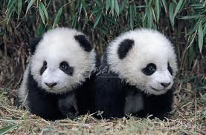
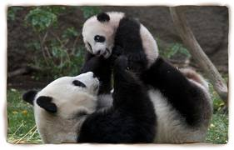
Habitat
Giant pandas live only in China.
Makes there homes in bamboo forests.
They use there paws to climb trees and hold bamboo stems.

Slide 4
Food
Giant pandas eat bamboo shoots, stems, and leaves.
These big animals eat up to 85 pounds (39 kilograms of bamboo each day.)

Slide 5
Life cycle
Female pandas give birth once each year.
Baby pandas are called cubs.
One or two cubs are born at a time.

Slide 6
Fun facts
Giant panda cubs weigh about 5 ounces.
(140 grams) at birth.
Giant pandas live about 20 years in the wild.
Pandas can swim very well.

Slide 7
Reference
http://www.pebblego.com/content/animals/pgo_player.php

