Slide 1
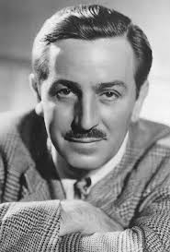
Walter Disney
By. Bradley Trapp

Slide 2
Introduction
Walt Disney created the most fun cartoon on TV.
Walt's first show was steam boat Willie in 1928.
He drew picture of his farm animals.

Slide 3
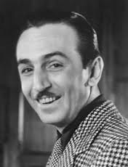
Early life
At age 16 Walt went to France for a movie company.
He drove an ambulance in world war 1.With his cartoon characters on it.
He started drawing more cartoon people.

Slide 4
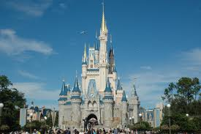
Achievements
He opened his Disney land in 1955.
The Florida park Disney World opened in 1971.
In 1937 he realest Snow White.

Slide 5
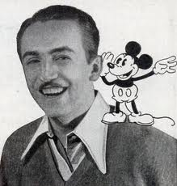
Contribution
Walts shows remain popular today.
People still visits his theme parks.
Walt Disney died on December 15,1966.

Slide 6
Rerences
http://www.pebblego.com/content/biographies/pgo_player.php

