Slide 1
Hurricanes
By ARIANA

Slide 2
What are they
Hurricanes are huge tropical storms
Hurricanes are huge big waves
Hurricanes are big ocean storms and waves

Slide 3
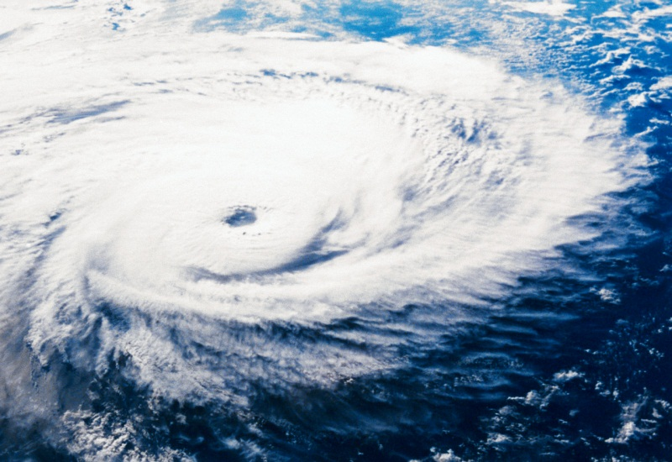
HOW DO THEY START
The wind starts to blow really hard
The wind and rain starts to make a thunderstorm
The storm brings strong wind, and heavy rain to shore.

Slide 4
WHO STUDIES THEM
Meteorologists use radar and satellites to show a path of a hurricane.
Hurricane hunters fly airplanes into the hurricane.
They measure the wind speed, pressure, and temperature.

Slide 5
How Are They Measured
A hurricanes strength is measured by its wind.
A hurricane is given a number from the Saffir- Simpson scale.
A hurricane is given a five or a one.

Slide 6
Staying Safe
Hurricanes have destroyed towns with floods and wind.
Listen to reports on the radio and tv.
Obey hurricane warnings that tell pepole to evacuate.

Slide 7
Reference
http://www.pebblego.com/content/science/pgo_player.php

