Slide 1
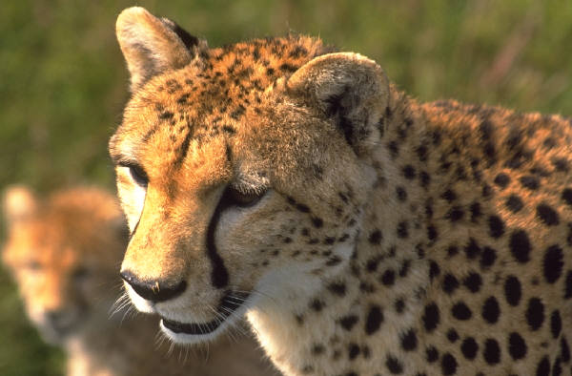
Cheetahs
By: Anna Reed

Slide 2
Body
Cheetahs are wild cats with long legs.
They can be up to seven feet long.
There yellow or tan fur is covered with spots.

Slide 3
Habitats
Most cheetahs live in Africa.
A few cheetahs live in Asia.
Cheetahs roam grassy areas called savannas.

Slide 4
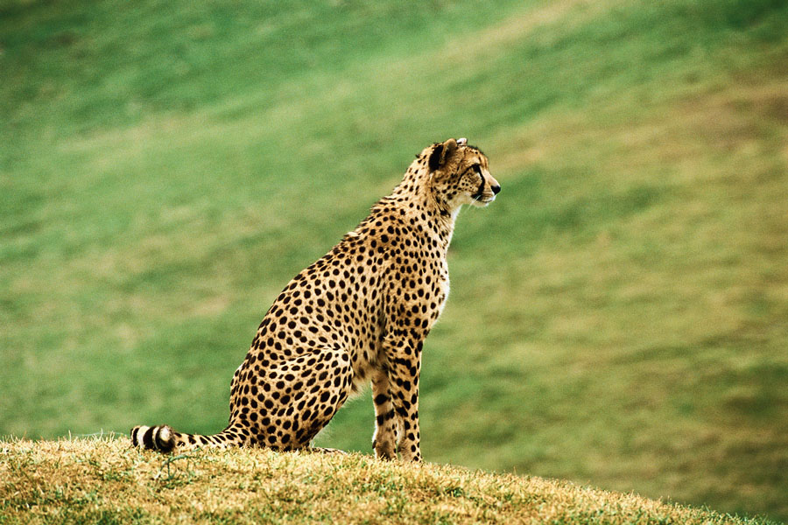
Food
Cheetahs are the fastest land animals.
They can run 70 miles per hour.
There speed helps them catch antelopes to eat.

Slide 5
Life Cycle
Female cheetahs can give birth to three to five cubs at a time.
Cubs are young cheetahs.
In the wild cheetahs live about ten to twelve years.

Slide 6
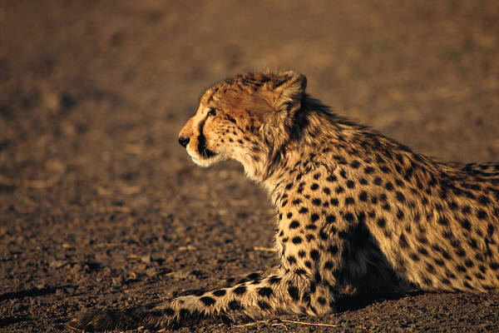
Fun Facts
Female cheetahs chirp to call there cubs.
Cheetah hunt during the day.
Black stripes near the eyes protects them from sun light.

Slide 7
Reference Page
http://www.pebblego.com/content/animals/pgo_player.php

