Slide 1
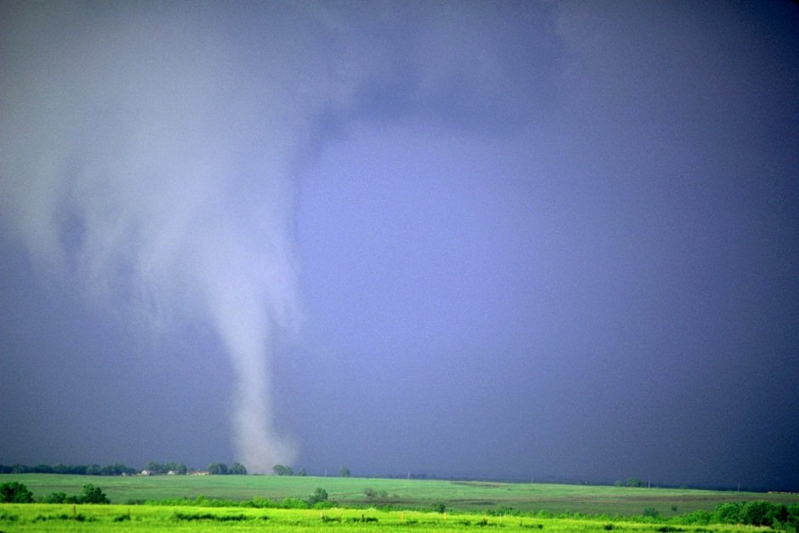
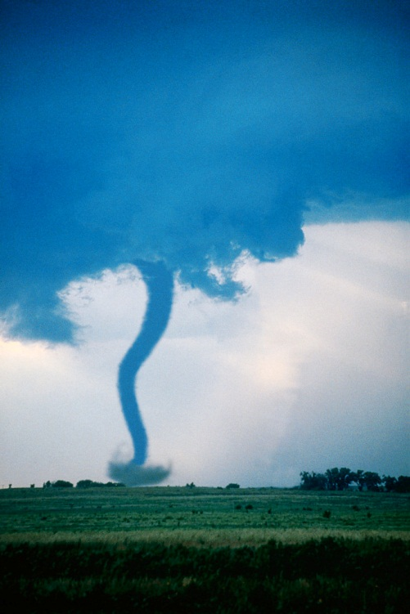
Tornadoes
By Angel

Slide 2
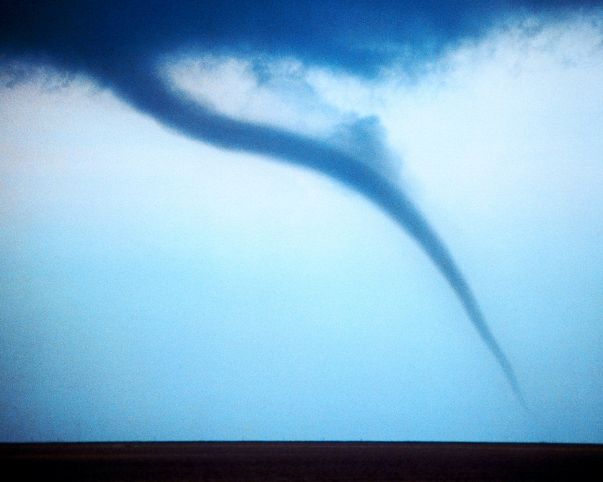
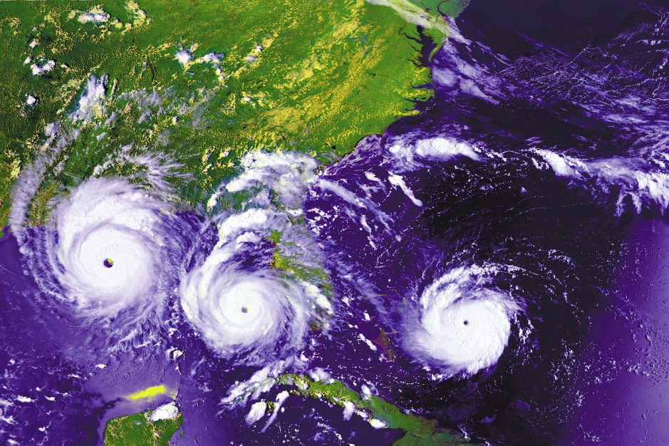
What Are They
A tornado is a funnel of wind
It is a tornado when it touches the ground
It is a strong wind storm

Slide 3
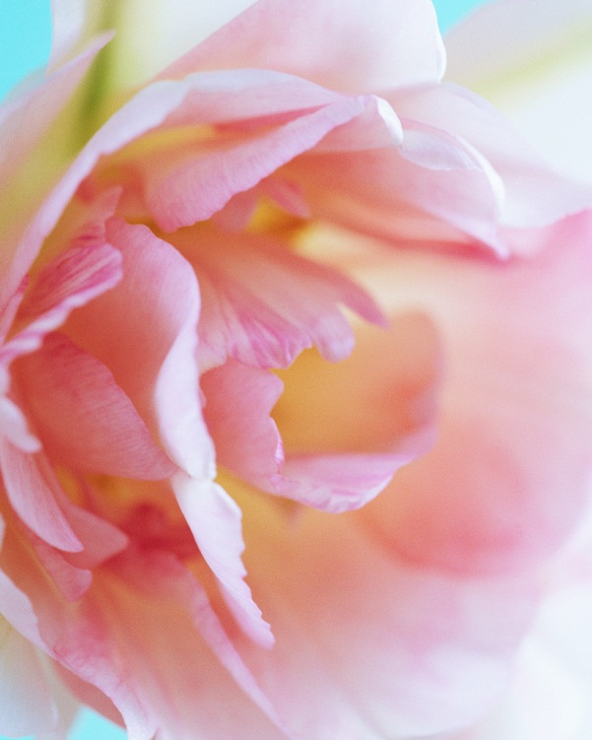
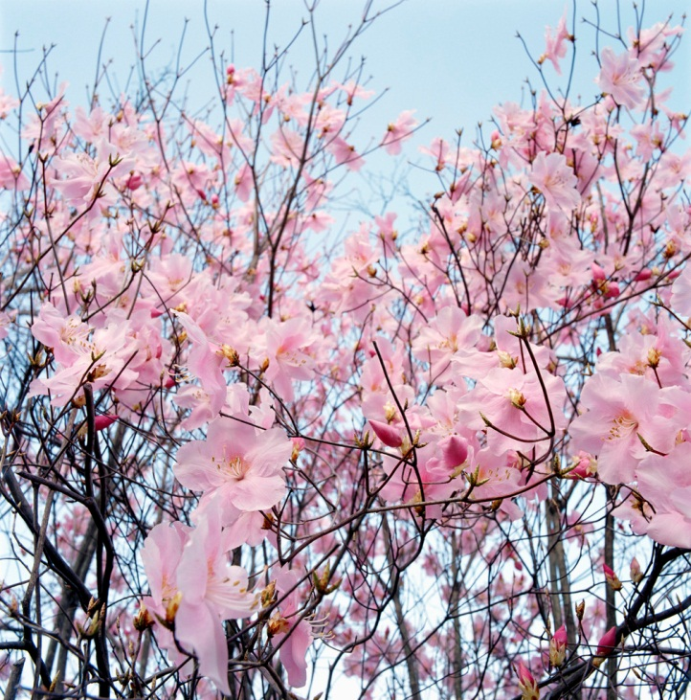
How Do They Happen
It happens when hot and cold air meet
They happen in spring
They even happen in summer

Slide 4
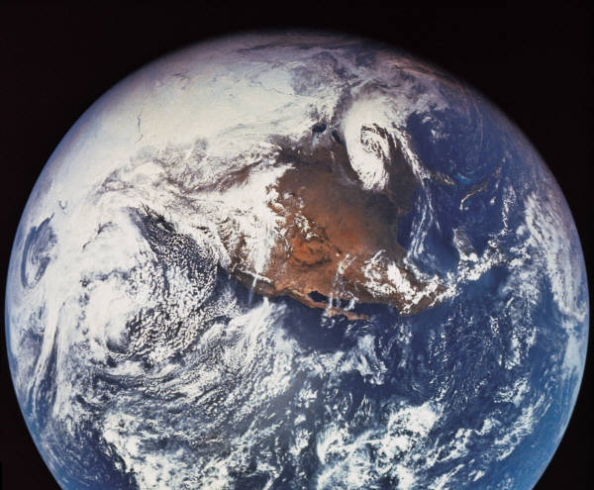
Where Do They Happen
It happens in a place called central United States
That place is called a tornado ally
They are all over the world

Slide 5
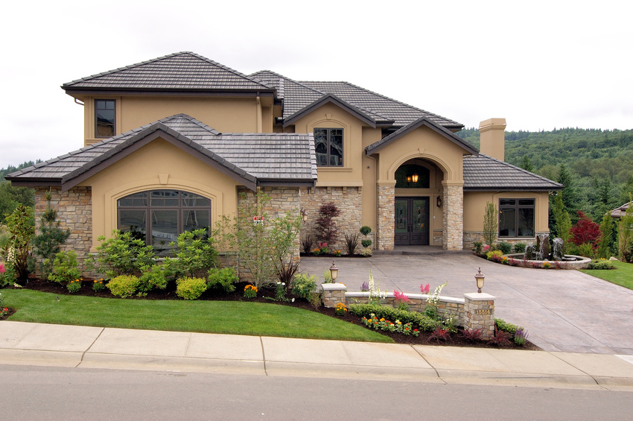
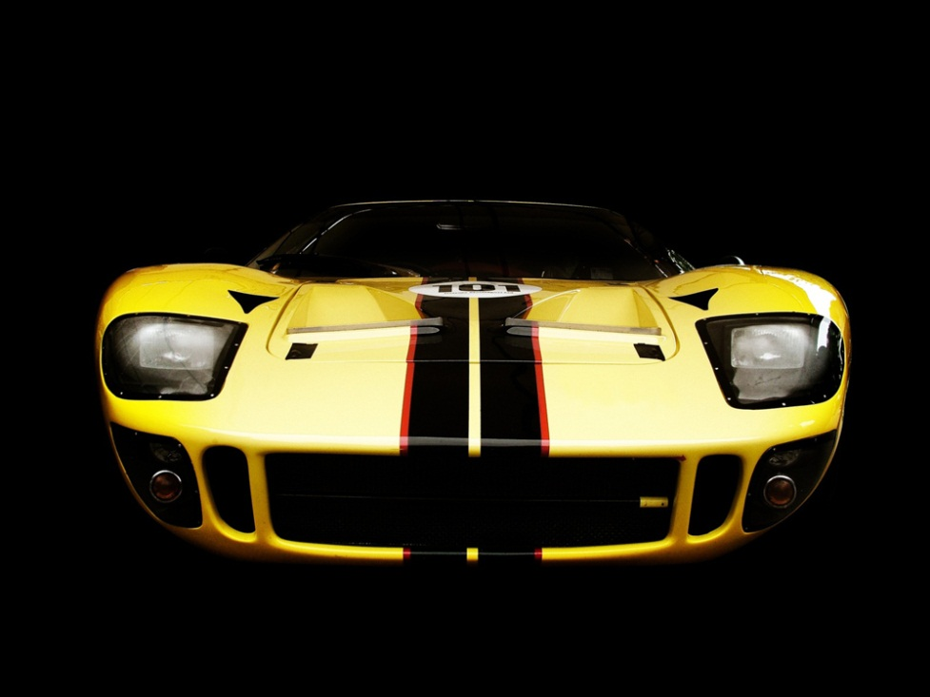
What Do They Do
They destroy every thing
They mess up peoples houses
It messes up peoples cars

Slide 6
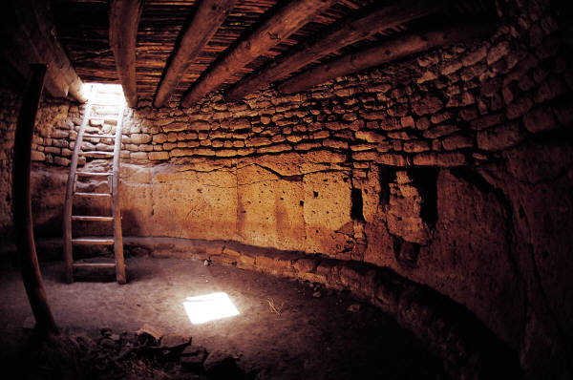
Tornado Safety
Go in the basement
Lie down in the ditch
Go in a windowless room

Slide 7
Reference
http://www.pebblego.com/content/science/pgo_player.php

