Slide 1
Cheetahs
By Andrew

Slide 2
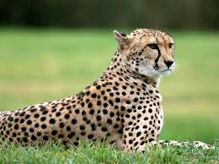
Body
A cheetahs body is seven feet (2.1 meters) long.
They have huge legs for running.
. Their yellow or tan fur is covered with black spots

Slide 3
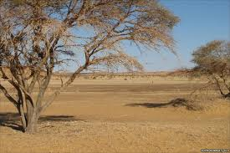
habitat
Most cheetahs live in Africa
And some live in Asia.
Cheetahs roam really grassy areas called savannas.

Slide 4
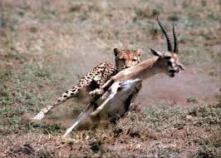
Food
Cheetahs are the fastest land animals fiscally.
They can run 70 miles (113 kilometers) per hour.
Their speed helps them catch food to eat.

Slide 5
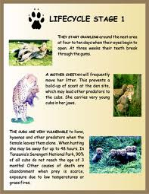
Life cycle
Female cheetahs give birth to three or five cubs at a time.
In the wild cheetahs live about 10 to 12 years old.
A cub is a baby cheetah

Slide 6
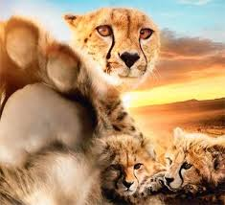
Fun Facts
Females chirp to call all of their cubs.
Cheetahs hunt during the day most of the time.
The black stripes near the cheetahs eyes protect their eyes from the sun light.

Slide 7
Reference
http://www.pebblego.com/content/animals/pgo_player.php

