Slide 1
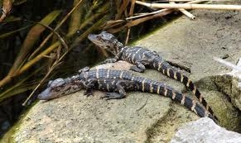
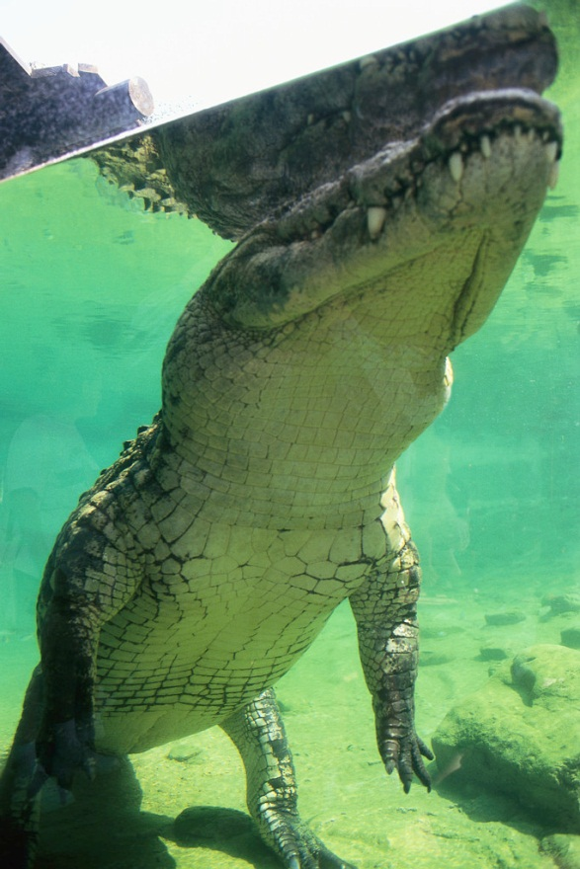
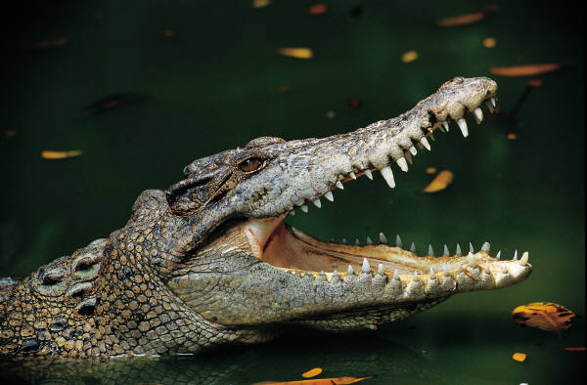
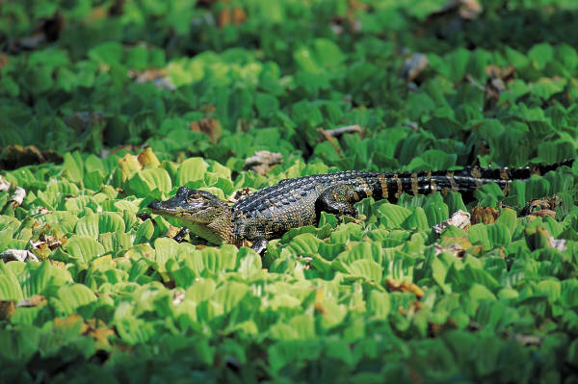
Alligators
By Alyssa

Slide 2
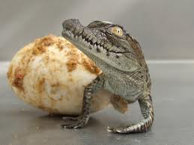
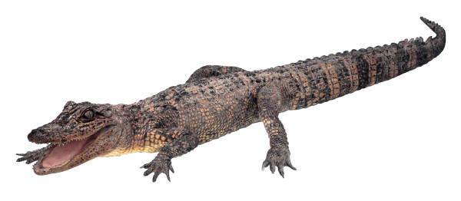
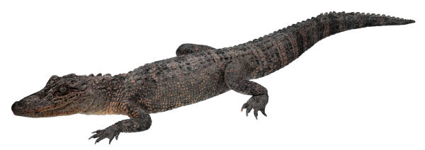
Body
Alligators weigh 1,000 pounds 450
Alligators have strong tails.
Big mouth with sharp , pointy teeth

Slide 3
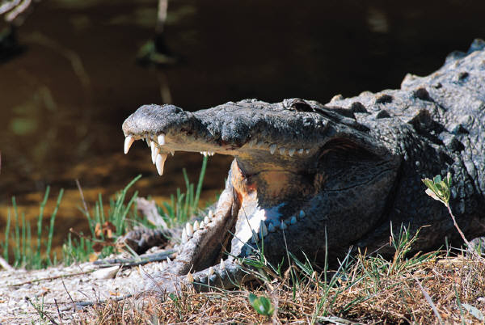
Food
Alligators eat once a week
They eat fish , snakes , and birds
They swallow small animals without chewing

Slide 4
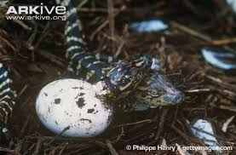
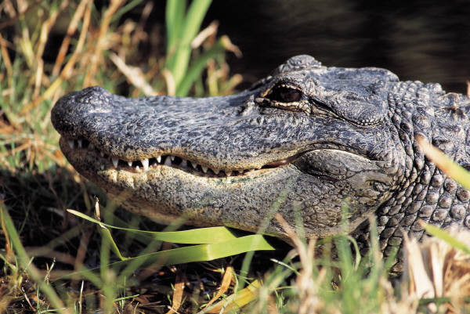
Habitat
Alligators live in wetlands
They can be found in United States
They can go on land and water

Slide 5
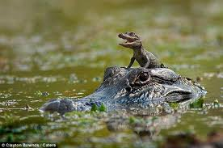
Life cycle
Female alligators lay 90 eggs
Hatchlings weigh less than 10 inches (25ncentimeters)
Alligators may live for 30 years

Slide 6
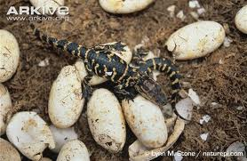
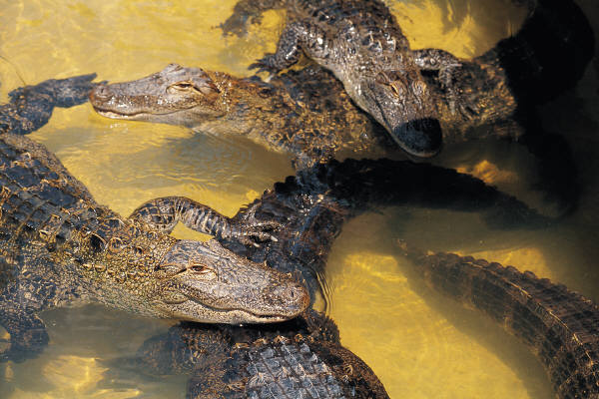
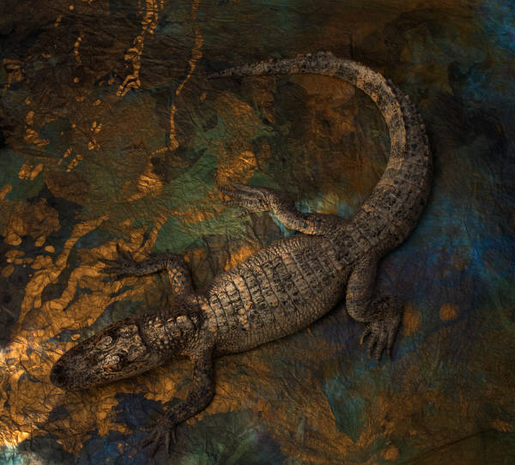
Fun Facts
Alligators grow now teeth
An alligators jaws can crack turtle shell
Alligators can go up two years without eating

Slide 7
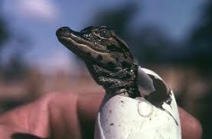
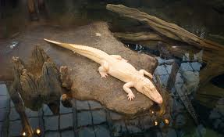
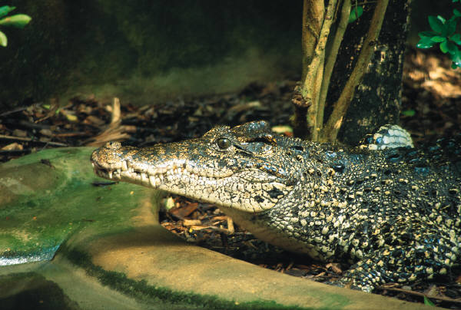
Reference
http://www.pebblego.com/content/animals/pgo_player.php

