Slide 1
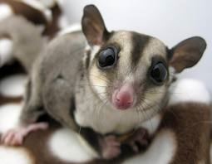
Sugar Gliders
By: Aleigha P

Slide 2
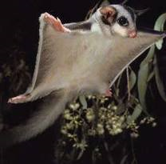
Body
A sugar glider has gray fur and a long tail.
Sugar Gliders Weighs 4 to 6 ounces (113 to 170 grams)
Its Hands and feet are connected to a flap of skin.

Slide 3
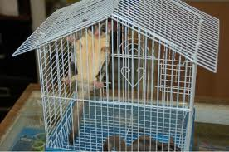
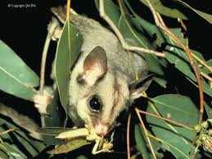
Habitat
The trees in Australia are were the sugar gliders live.
The small marsupial jumps off high branches And their flaps open so they can glide from tree to tree.
Predators on the ground can not reach them.

Slide 4
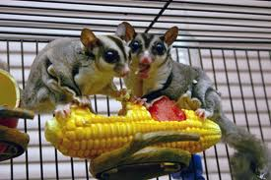
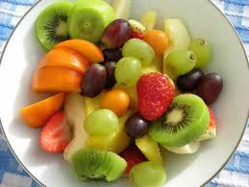
Food
Their diet is very simple.
Bugs
Nectar And sap
They have a sweet tooth for fruits.

Slide 5
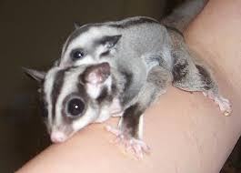
Life Cycle
Female sugar gliders have pouches were they keep their babies in.
The babies stay in the pouches for 70 days.
10 months a sugar glider is fully grown.
Sugar gliders live about 9 years.

Slide 6
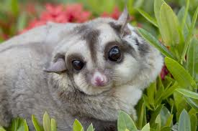
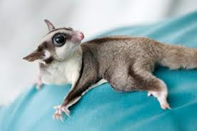
Fun Facts
Did you know sugar glider bark like dogs and chirp like birds.
When groups of sugar glider are frightened they chatter loudly.
They can glide 160 feet (50 meters) or more

Slide 7
Reference
http://www.pebblego.com/content/animals/pgo_player.php

