Slide 1
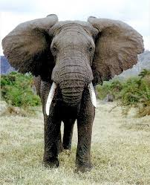
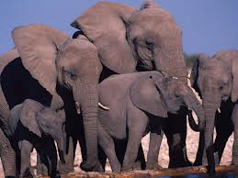
African Elephants
By Ahlyvia Ayre

Slide 2
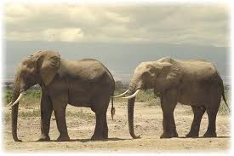
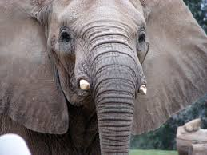
African Elephant’s Body
African Elephants are giant mammals.
African Elephants can reach up to 4 meters tall.
African Elephants have big ears.
African Elephants have thick gray skin.

Slide 3
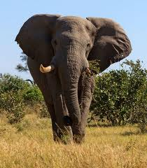
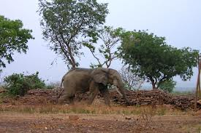
African Elephants Habitats
African Elephants live in Africa.
African Elephants find food on savannas.
African Elephants Find food on flat land.

Slide 4
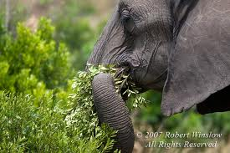
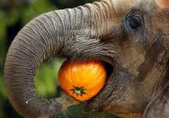
African Elephants Food
African Elephants can eat more than 200 pounds of food every day.
African Elephants eat fruit grass and leaves.
African Elephants tare bark from trees.

Slide 5
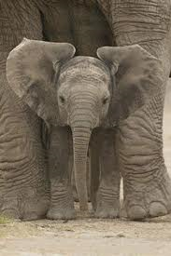
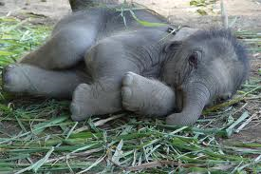
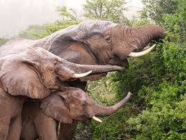
African Elephants Life Cycle
A baby African Elephant is called a calf.
African Elephants can live to be 60 years old.
When a baby African Elephant is born all the females in the hard helps raise it.

Slide 6
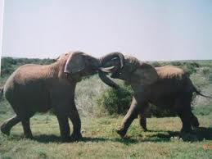
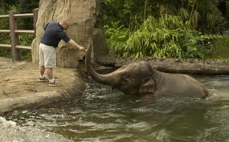
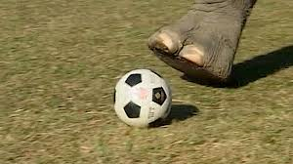
Fun Facts
African Elephants can weigh up to 15,400 pounds.
African Elephants roll in mud every day.
African Elephants swim every day.
African Elephants Use there big tusks to fight.

Slide 7
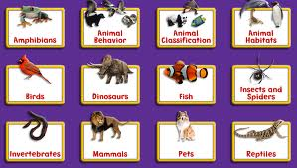
References
http://www.pebblego.com/content/science/pgo_player.php

